Slide 1

Modern Theory of Wetting: Theory and Experiment
Edward Bormashenko
The Ariel University, Ariel, Israel
Харьковский национальный университет имени В. Н. Каразина, Октябрь, 2013.

Slide 2
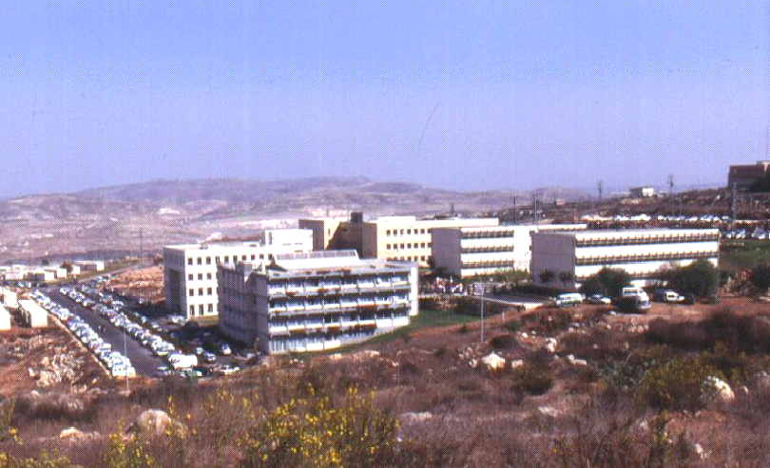

Slide 3
Motivation
Solid/liquid interfaces are responsible for a diversity of natural and technological phenomena
Interfacial phenomena at real solid/liquid interfaces are not clearly understood

Slide 4
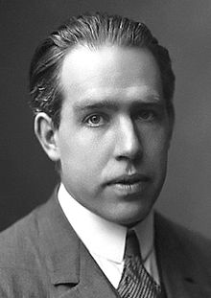

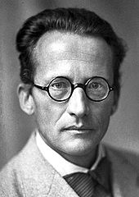
Einstein, Shrödinger and Bohr devoted their research activity to wetting phenomena
Shrödinger E. Notiz über den Kapillardruck in Gasblasen, Annalen der Physik, 1915, 351 (3), 413-418.
Einstein A., Folgerungen aus den Capillaritätserscheinungen, Annalen der Physik, 1901, 309 (3), 513-523.
Bohr N. Determination of the Surface-Tension of Water by the Method of Jet Vibration, Phil. Trans. R. Soc. Lond. A, 1909, 209, 281-317.

Slide 5
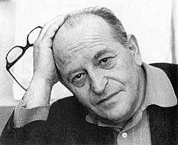
Лекция посвящается светлой памяти Якова Евсеевича Гегузина, блестящего ученого и педагога.

Slide 6
Outline
What is wetting? Main scenarios of wetting. Statics of wetting. Spreading parameter.
What is surface tension? Surface tension and surface energy of solids and liquids.
The Young equation.
Contact angle hysteresis. Its sources and manifestations.
Universal scaling laws describing roughness of the triple line
Dynamics of wetting.

Slide 7
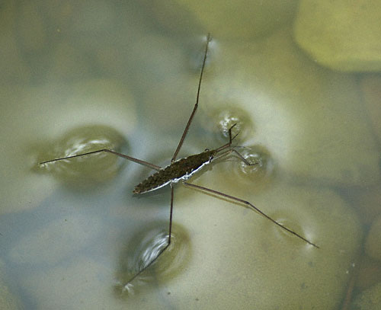

Slide 8
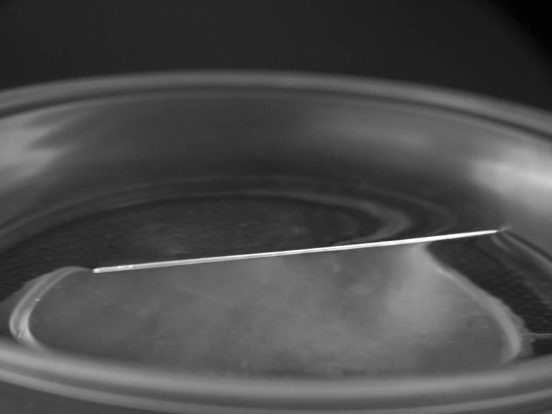

Slide 9
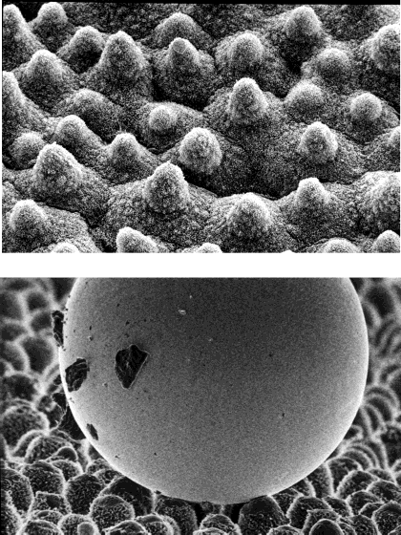
The Phenomenon of Superhydrophobicity
Barthlott, W.; Neinhuis, C. Planta 1997, 202, 1-8.
Twin-scale
roughness

Slide 10
Physics is the science which deals with small parameters … (L. Landau)
Solid
Gas
Liquid

Slide 11
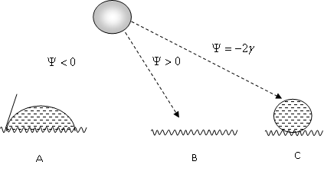
Main wetting scenarios

Slide 12
A molecule at the surface misses half its interactions

Slide 13
and
are the specific surface energies at the rough solid/air and solid liquid interfaces
de Gennes, P. G.; Brochard-Wyart, F.; Quéré D. Capillarity and Wetting Phenomena, Springer, Berlin, 2003.

Slide 14
High-energy surfaces:
High-energy surfaces are inherent for materials built with strong chemical bonds such as ionic, metallic or covalent.
Low-energy solid surfaces:
Polymer materials
Erbil H. Y. Surface Chemistry of Solid and Liquid Interfaces, Blackwell, Oxford, 2006.

Slide 15
Triple line governs wettability and related phenomena
gas
triple line
liquid
solid

Slide 16

Wetting of the flat substrates
Young Th. An Essay on the cohesion of liquids, Phil. Trans. Royal Society of London, 1805, 95, 65-87.
γ
γ_{SA}
θ
γ_{SL}
θ – local (Young) contact angle

Slide 17
2D Wetting Problem
h
U(h)
θ
θ
-a
a
x
E. Bormashenko, Colloids and Surfaces A: 345 (2009) 163–165

Slide 18
The problem is reduced to the minimization of the functional

Slide 19
What are the transversality conditions of variational problem?
y
x
x₀
x₁

Slide 20
The Transversality Condition:

Slide 21
The Young Equation is Recognized
(

Slide 22
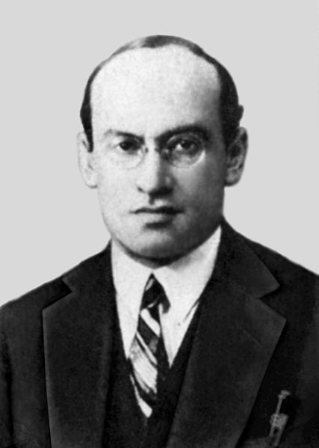
Y. I. Frenkel first demonstrated that the Young equation is actually the boundary condition of the problem of wetting
Frenkel Y. I., On the behavior of liquid drops on a solid surface. I. The sliding of drops J. Exptl. Theoret. Phys. (USSR) 1948, 18, 659.

Slide 23
The Line Tension
The Young-Boruvka Equation

Slide 24
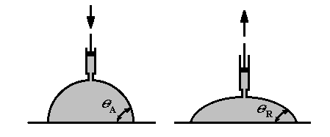
What is the contact angle hysteresis (CAH)?

Slide 25
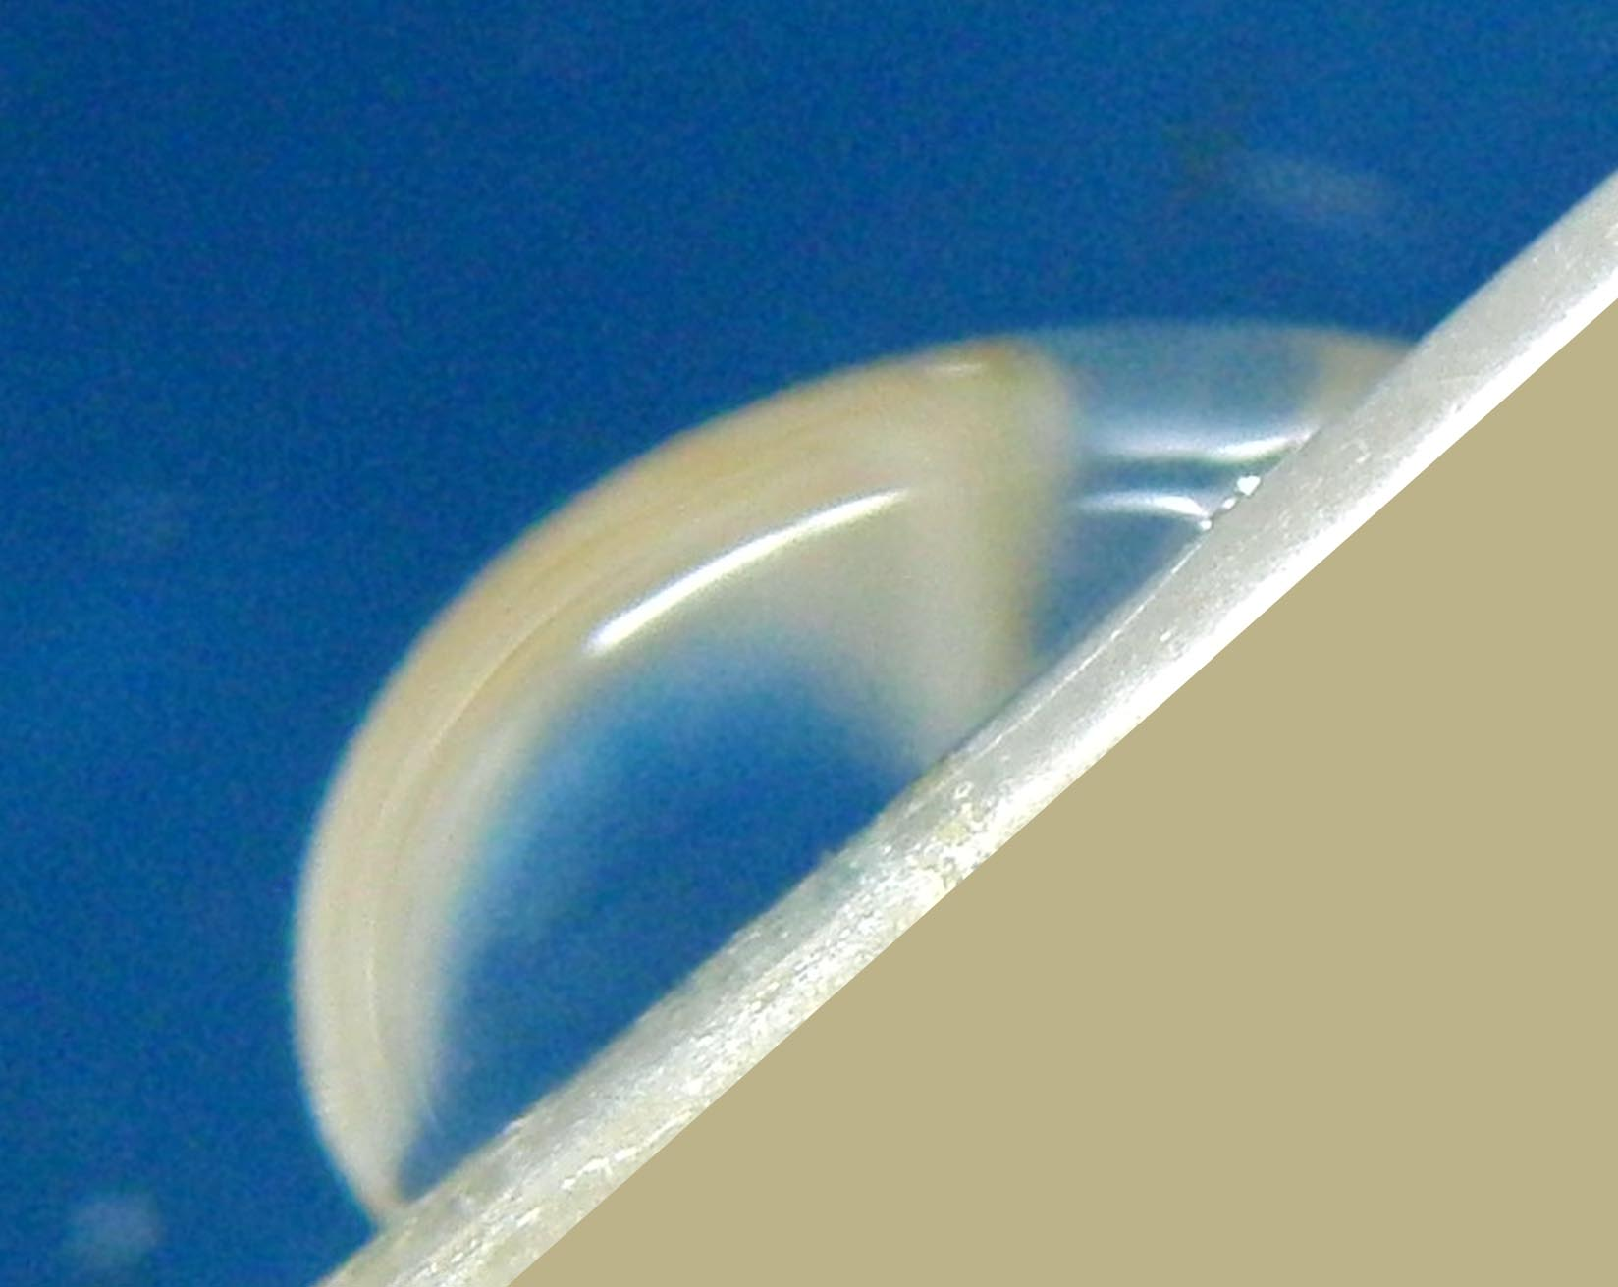
θ₁
θ₂
α

Slide 26
Manifestation of the contact angle hysteresis
2R
θ₁
H
θ₂

Slide 27
Contact angle hysteresis
Chemical heterogeneities
Physical heterogeneities

Slide 28

FLAT SURFACES
Contact angle hysteresis is observed on atomically flat surfaces
Experimental data concerning contact angle hysteresis are contradictory and sensitive to the experimental technique

Slide 29

Materials
Extruded polymer films of:
low density polyethylene (PE),
polypropylene (PP),
polyethylene terephthalate (PET),
polysulfone (PSU),
polyvinylidene fluoride (PVDF unpoled),
polyvinylidene fluoride (PVDF poled)

Slide 30
Experimental Techniques
needle-syringe method
evaporation of the drop
deformation of the drop

Slide 31
The New Technique for CAH Measurement
Precise micrometrical stage
θ_{adv}
θ_{rec}
Teflon plate
Water droplet
θ
Polymer film
Horizontal plate
Bormashenko, E.; Bormashenko, Y.; Whyman, G.; Pogreb, R.; Musin, A.; Jager, R.; Barkay, Z. Langmuir; 2008; 24, 4020-4025

Slide 32
The New Technique for CAH Measurement
θ_{adv} θ_{rec}
Precise micrometrical stage
Polymer film
Teflon plate
Laser
θ
Water droplet
Screen
Bormashenko E., et al., Contact angle hysteresis on polymer substrates established with various experimental techniques, its interpretation, and quantitative characterization, Langmuir, 2008, 24, 4020-4025.

Slide 33
Results of CAH Measurements
Advancing angle:
excellent agreement of advancing angles measured with the needle-syringe method and pressing the drop for PE, PET and PSU substrates
satisfactory agreement for poled and non-poled PVDF and PP
Max. discrepancy for PP - 8º

Slide 34

Results of CAH Measurements
Receding angle
High discrepancy for all polymer substrates
as high as 24º for PE substrates
Neumann and Chibowski:
Receding contact angles on a dry surface are experimentally conceptually inaccessible

Slide 35
Factors exerting an influence on the contact angle hysteresis
Chemical and physical heterogeneities of the surface
Roughness
Deformation of the Surface
Precursor film surrounding the drop

Slide 36
Deformation of the Surface
Shanahan M. E. R., Carre A., Viscoelastic dissipation in wetting and adhesion phenomena, Langmuir, 1995, 11, 1396-1402.
Vapor
θ
Liquid
ζ
Solid
Є
x
0

Slide 37
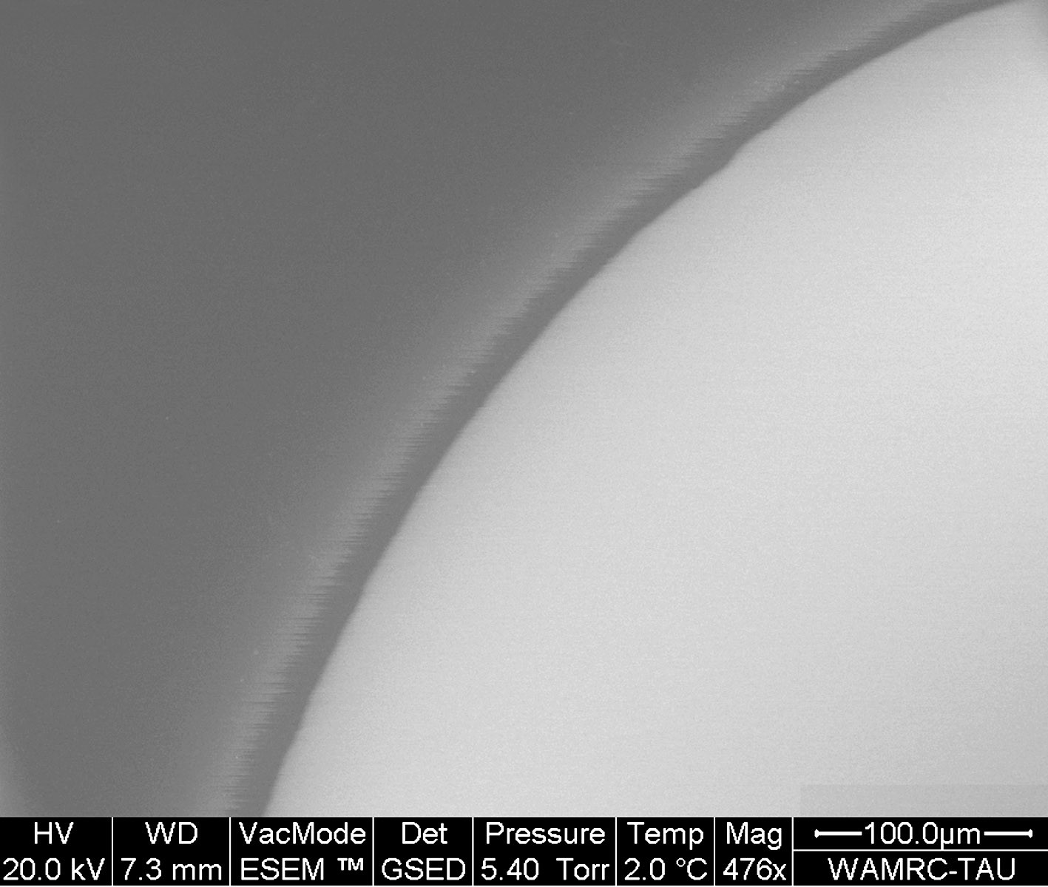
Fine structure of the triple line and the receding contact angle
H
r
e
θ
R

Slide 38
Disjoining Pressure
Derjaguin B.V., Churaev N. V. Structural component of disjoining pressure, J. Colloid & Interface Sci. 1974, 49, 249-255.
e
e

Slide 39
Starov V. M., Velarde M. G. Surface forces and wetting phenomena,
J. Phys: Condens. Matter, 2009, 21, 464121.
1
2

Slide 40
Wetting of Rough Surfaces.
Imaging of The Triple Line with ESEM
What is the Scaling Law Describing the Roughness of the Triple Line?

Slide 41
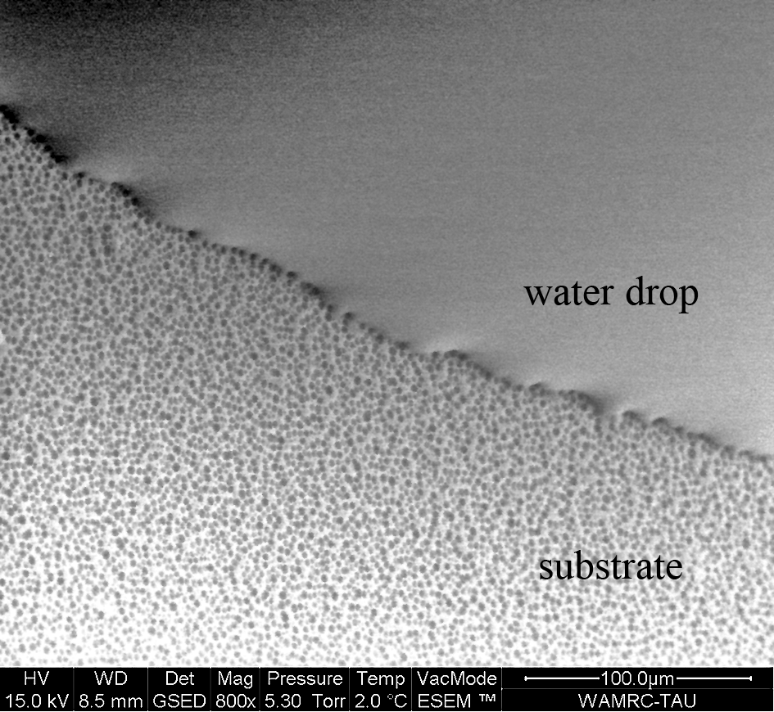
ESEM images of the triple line on the polycarbonate surface

Slide 42
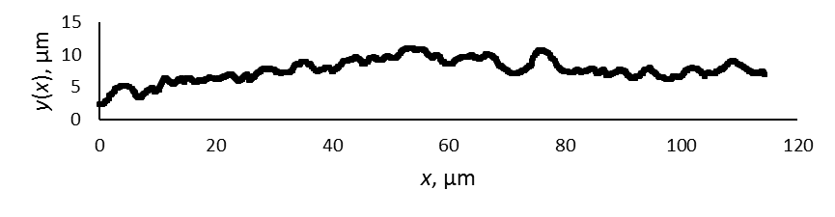
Universal Scaling Law Describing Roughness of the Triple Line
ζ = 0.63±0.02 expanding regime; ζ = 0.60±0.05 retreating regime

Slide 43
Dynamics of wetting
The dynamic contact angle does not equal to the static one!

Slide 44
Origin of the dynamic contact angle: A. The dynamic contact angle is larger than the Young angle ; B. The opposite situation: the dynamic contact angle is smaller than the Young angle .
r
γ
F
θ
θ
Y
D
γ
γ
LA
SA
A
r
F
γ
θ
θ
Y
D
γ
γ
LA
SA
B

Slide 45
Formation of the dynamic contact angle according to Voinov

Slide 46
Voinov-Cox Law
Voinov O. V., Hydrodynamics of wetting, Fluid Dynamics, 1976, 11, 714-721.

Slide 47
Conclusions
Wetting arises from the complicated interplay of surface energies of the solid and liquid phases.
Physical phenomena occurring in the vicinity of the triple line govern wetting of solid surfaces.
The spectrum of contact angles exists due to the contact angle hysteresis
Universal scaling law describing the roughness of the triple line was established.

Slide 48
Conclusions
Wetting is influenced by long range (van der Waals) forces) resulting in the disjoining pressure.
Wetting is also influenced by a line tension, the precise value of the line tension remains obscure.
The dynamic wetting is described by the “dynamic contact angle”

Slide 49
The Trends of Future Investigations:
The fine structure of the triple line has to be studied with independent experimental techniques (AFM, ESEM, ellipsometry).
2. The mathematical model describing pinning of the triple line, taking into account the inter-molecular interactions between liquid and substrate molecules has to be developed.
The role of the line tension should be clarified.
Methods of control of surface energy of solids are of a primary importance.

Slide 50
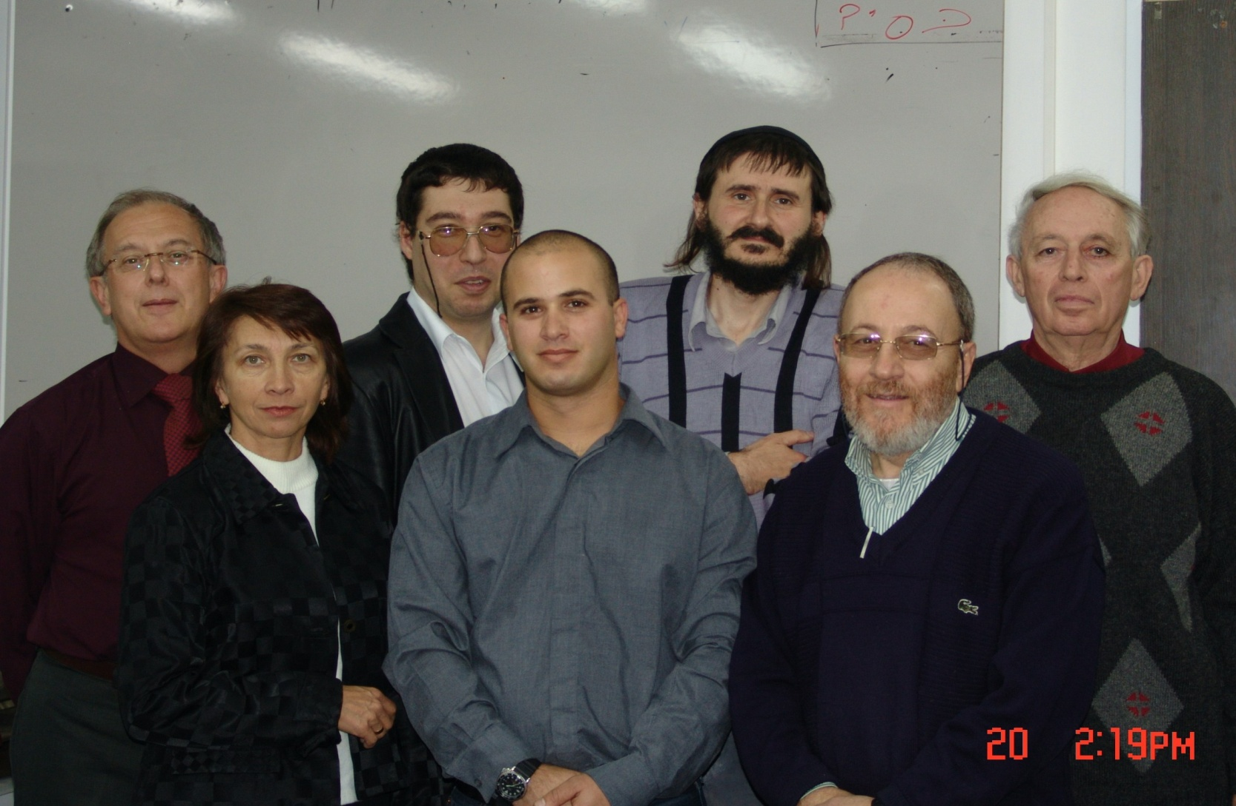

Slide 51
Acknowledgements
The author is grateful to Professor Kazachkov for numerous inspiring discussions and fruitful cooperation.
The author is thankful to Professor Voronel for fruitful discussions.
The author is thankful to Mrs. N. Litvak and Mrs. Zahava Barkay for SEM and ESEM imaging

Slide 52
Thanks for Invitation!

