Slide 1
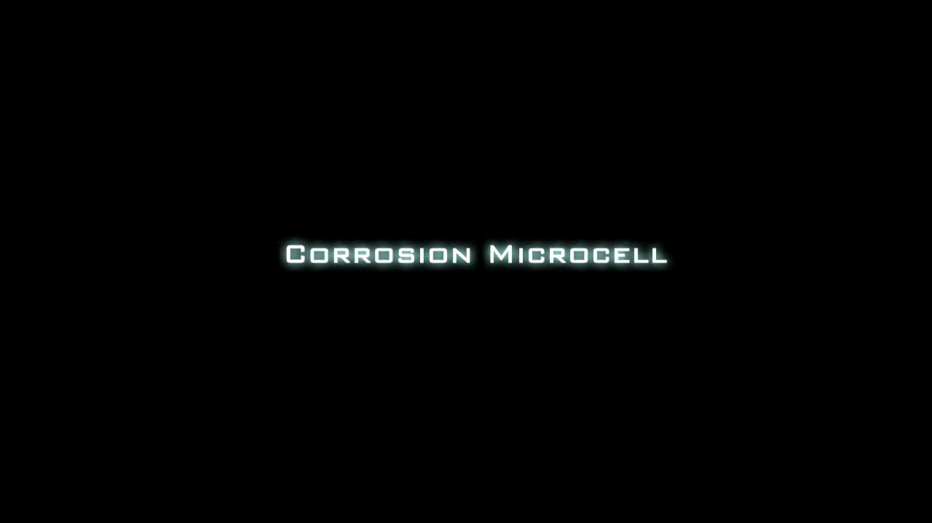
Cathodic corrosion - a quick, clean and versatile method for the synthesis of metallic nanoparticles
A. Yanson
The essence of corrosion

Slide 2
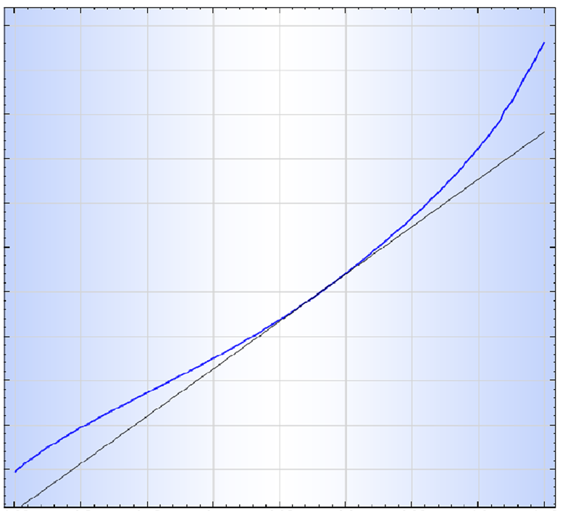
Common corrosion is anodic, it always proceeds via oxidation of a metal to its cation:
Pt ↔ Pt²⁺ + 2 e⁻ (+1.19 V)
Fe ↔ Fe²⁺ + 2 e⁻ (-0.44 V)
Zn ↔ Zn²⁺ + 2 e⁻ (-0.76 V)
Corrosion of a screw in sea water
oxidation
anodic
Current
cathodic
equilibrium
(red-ox)
potential
reduction
-1 -0.8 -0.6 -0.4 -0.2 0
Potential applied (V)
If making metal more positive speeds up corrosion, making it more negative …
Electrochemical measurement - voltammogram

Slide 3
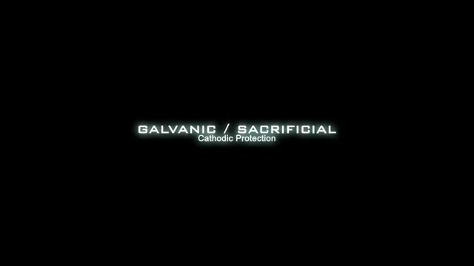
Cathodic protection
To keep an easily oxidizable metal from corroding we need to constantly “feed” it with extra electrons, either from external power supply or by corroding a sacrificial anode:
What will happen if we take a platinum electrode and make it a cathode?
Cathodic protection - galvanic

Slide 4
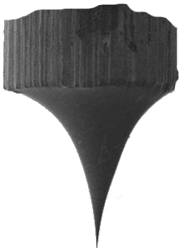
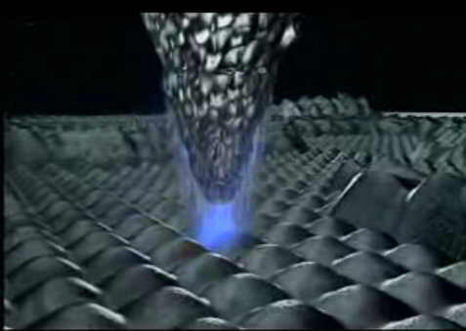
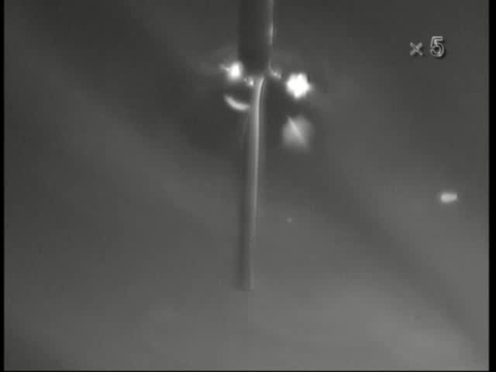
Scanning Tunneling Microscope (STM) needs an atomically sharp tip made of a very stiff and chemically inert metal
W etching in NaOH:
STM tip etching

Slide 5
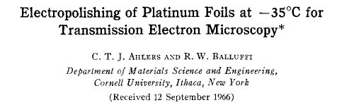

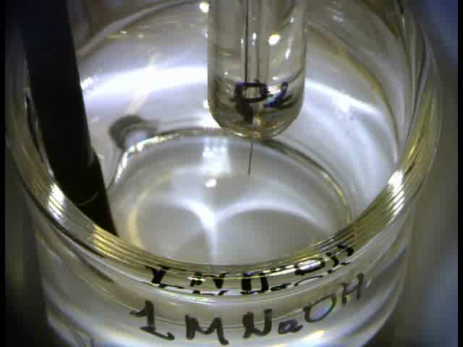

A literature recipe for
Pt-Ir tip etching:
- seems to work just fine,
doesn’t it?
- but 50Hz is so boring!
Let’s use a function generator and
see how frequency influences the
etching process
AC high voltage PtIr etching

Slide 6
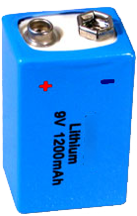
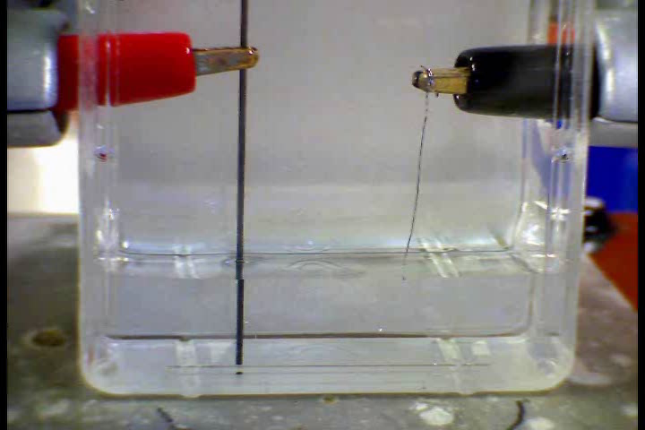
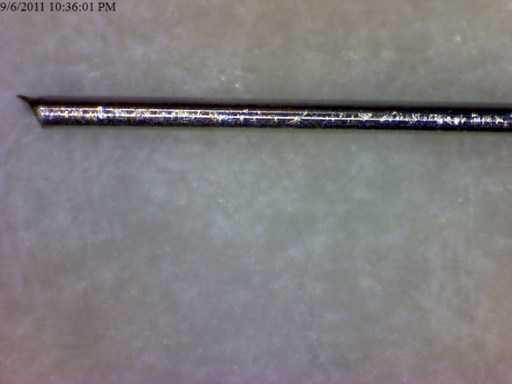
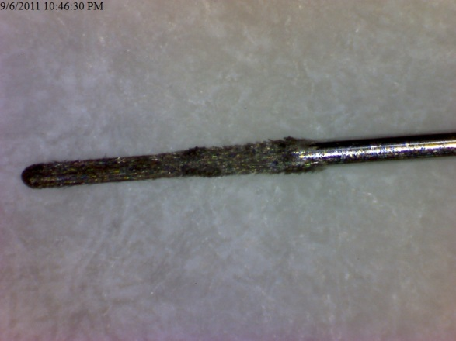
The case of zero frequency (water electrolyis):
99.99% Pt
∅ 0.1mm
Cathodic treatment of a Pt wire at -10V in 10M NaOH

Slide 7
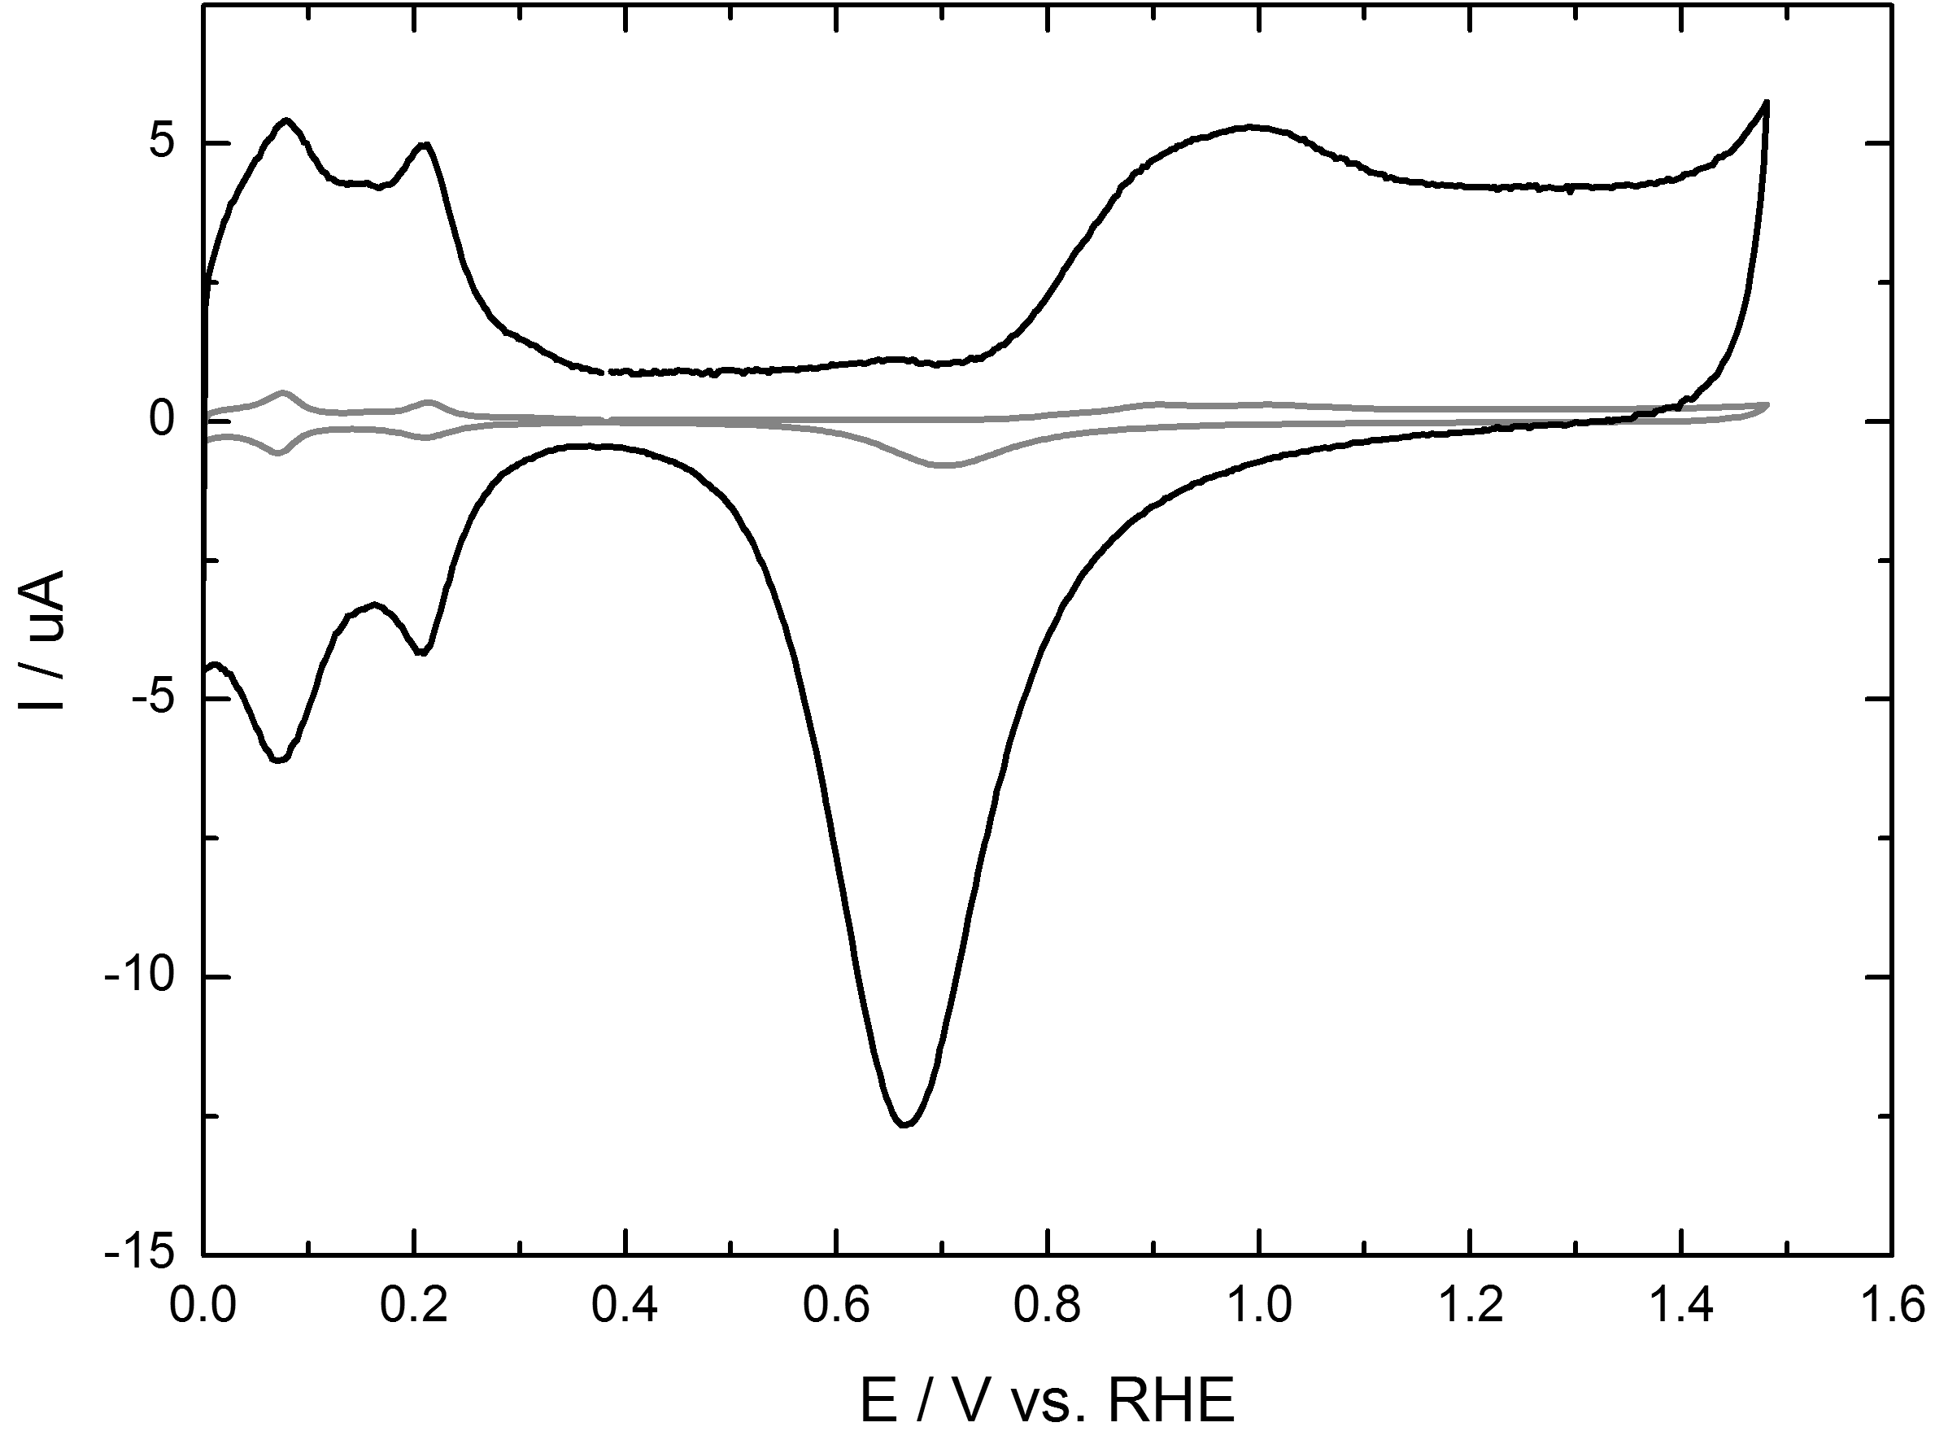
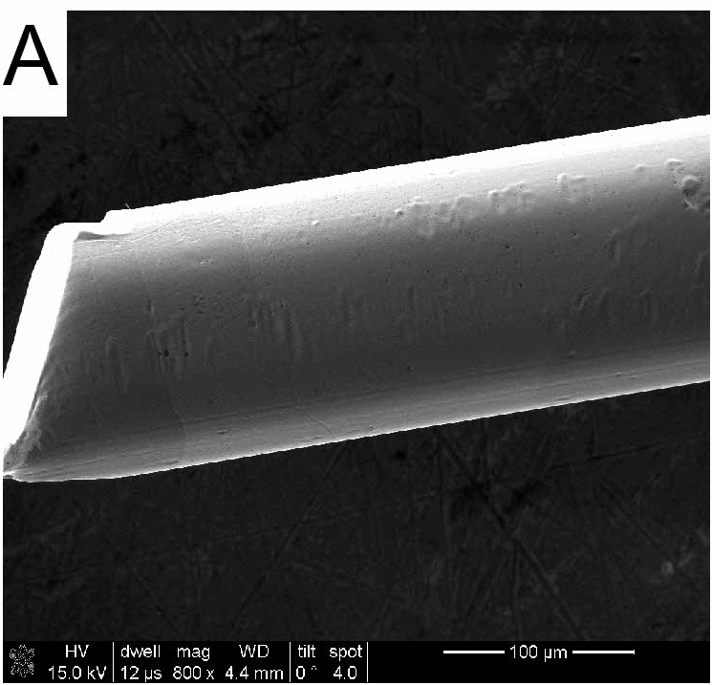
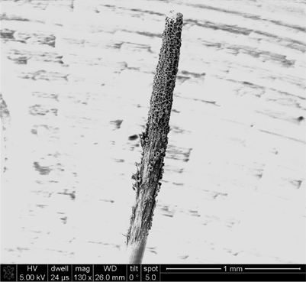
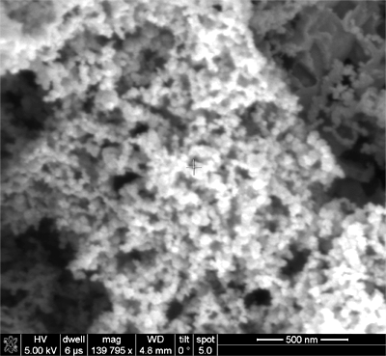
Cathodic treatment of Pt
(10M NaOH, -10V, 1000 sec)
Cyclic voltammogram of Pt in H₂SO₄
before
SEM images of electrode surface
Surface area
increase x17
after
Yet another way to make platinum sponge?
Or does this look like nanoparticles?!

Slide 8
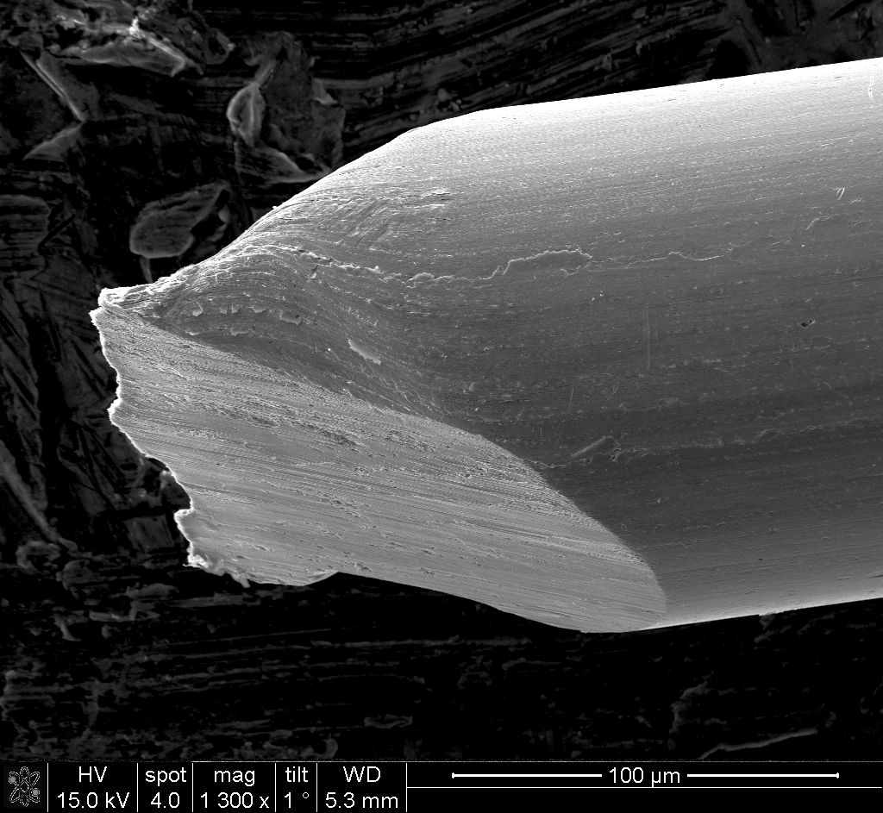
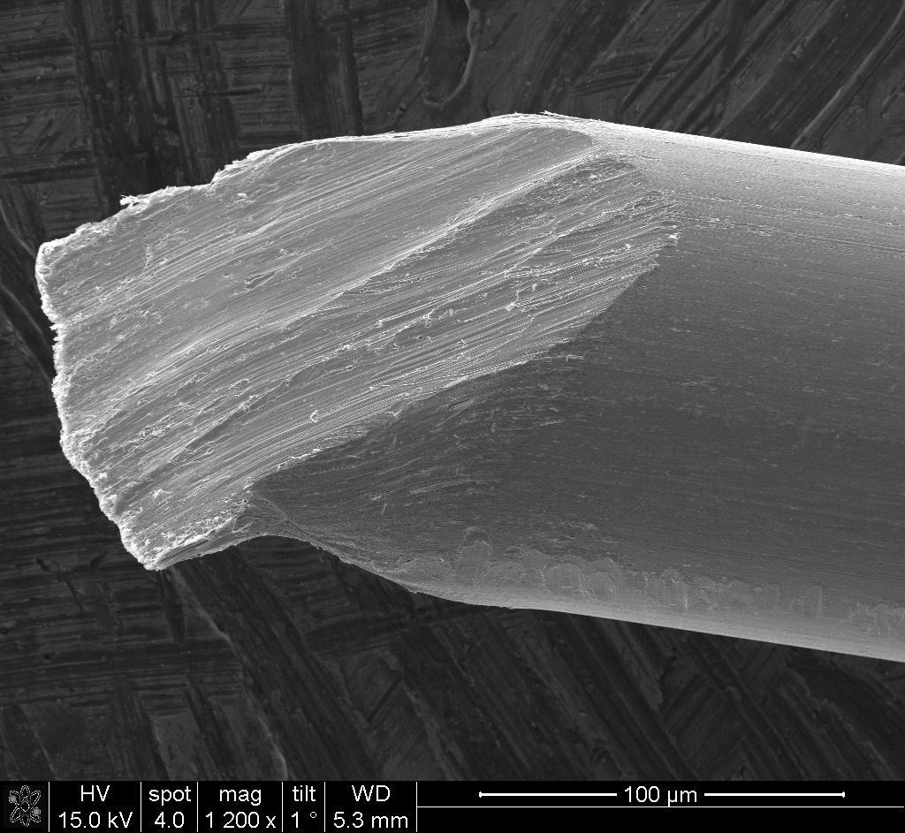
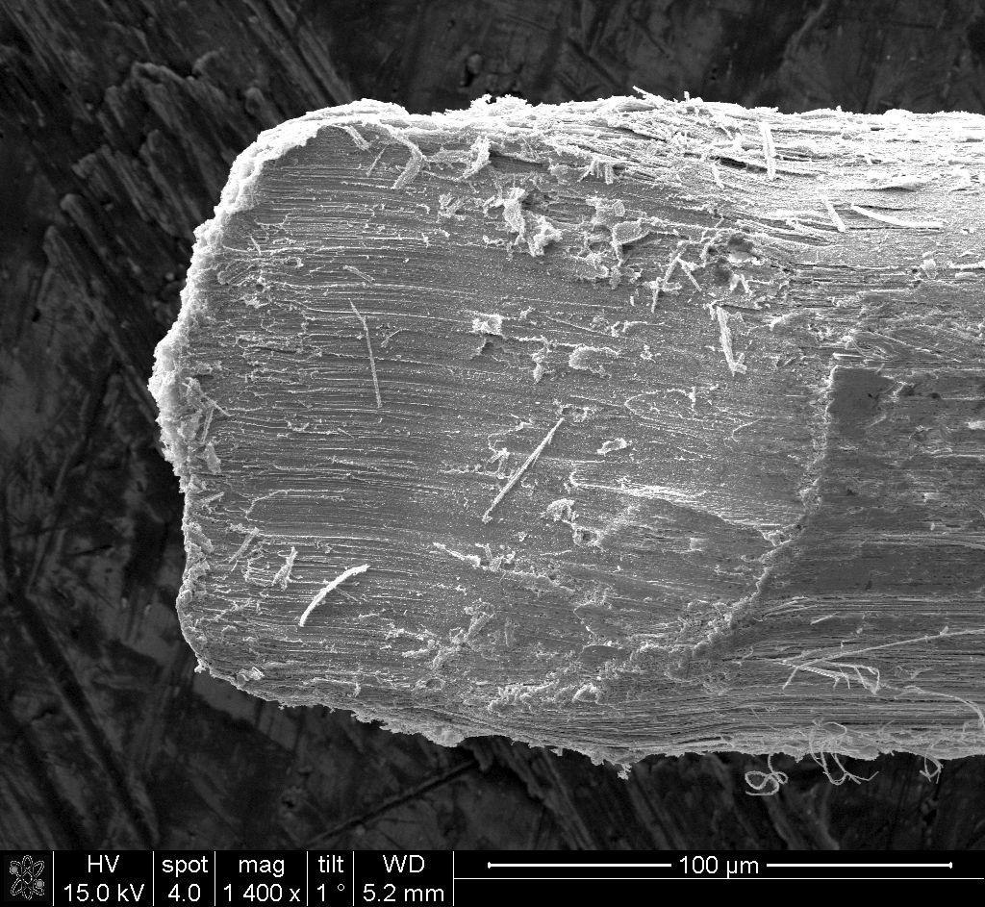
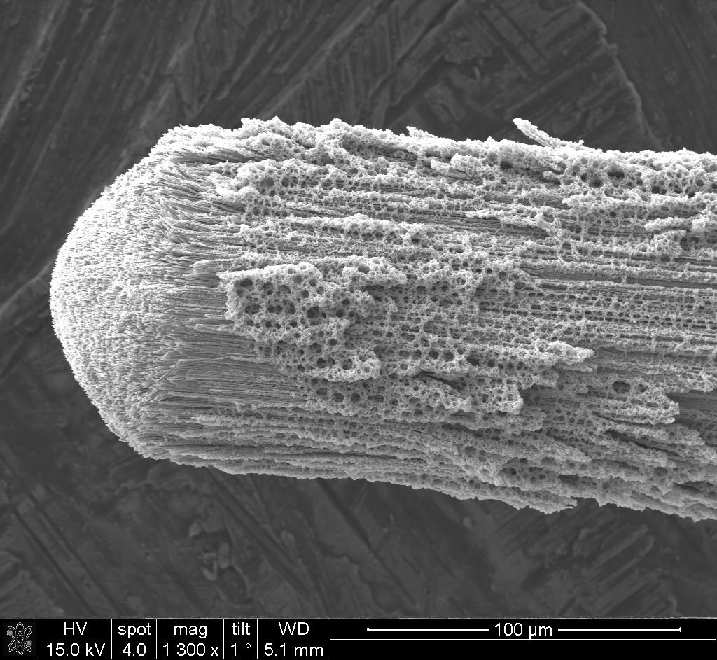
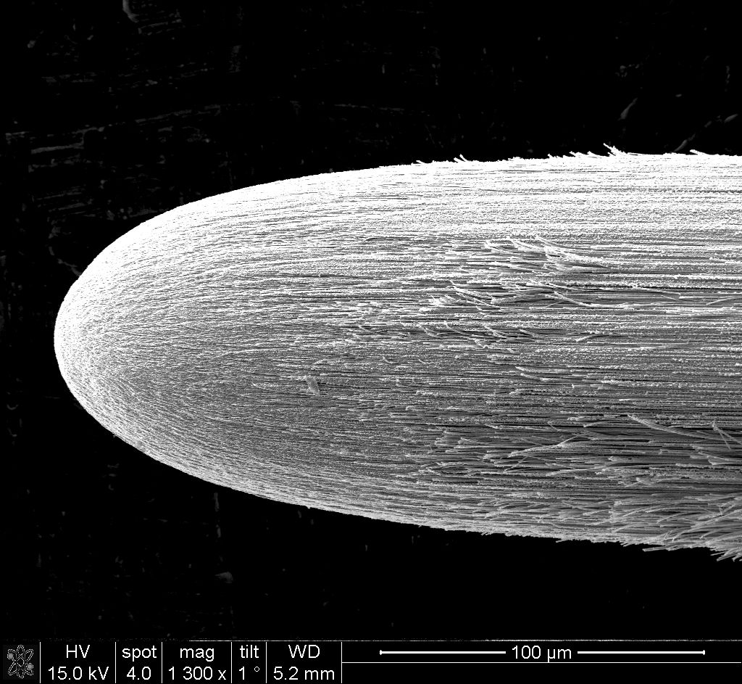
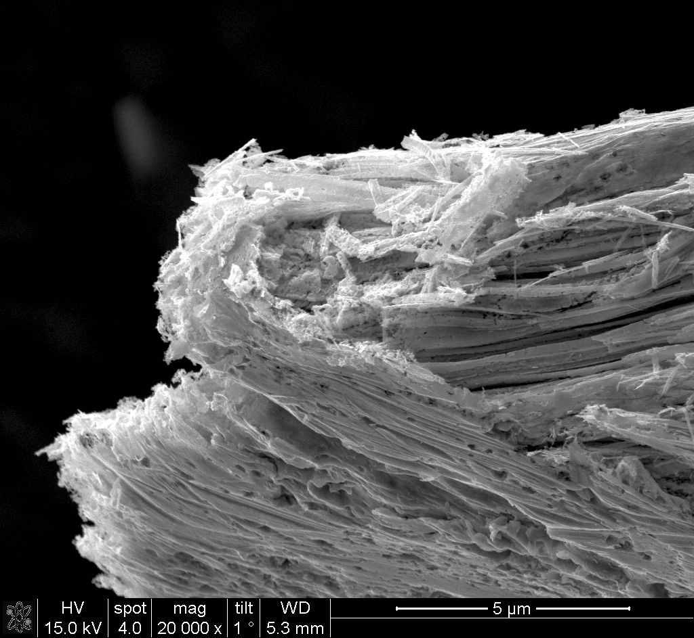
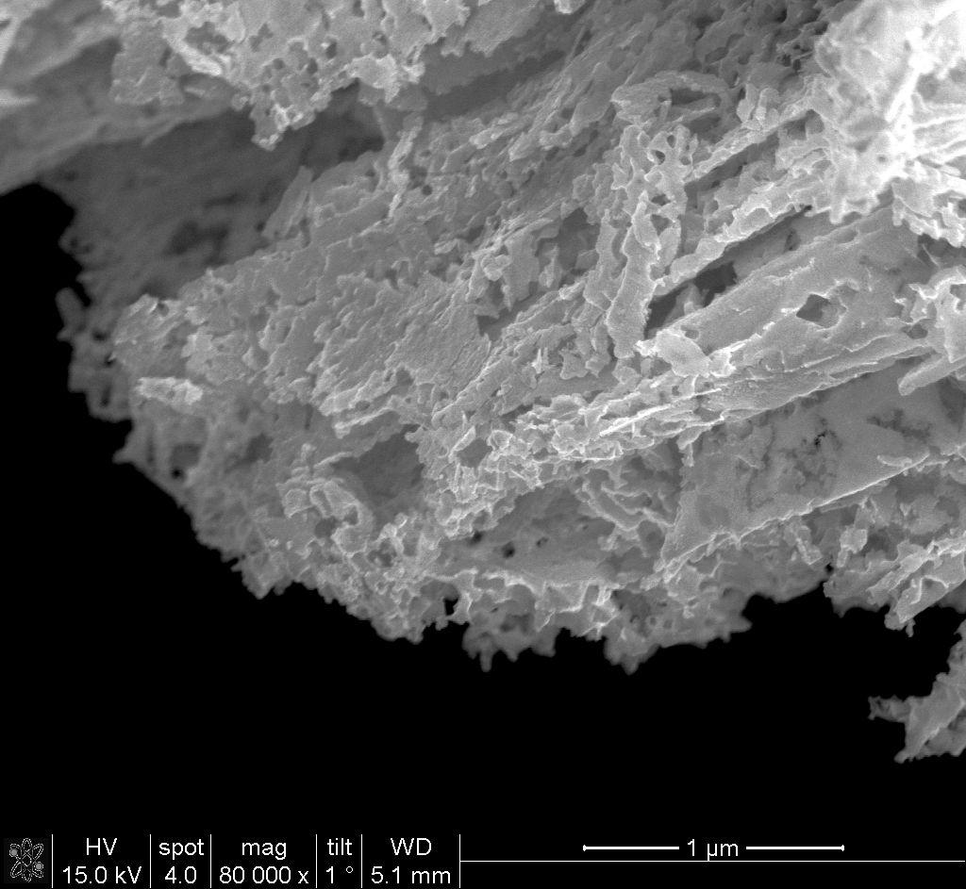
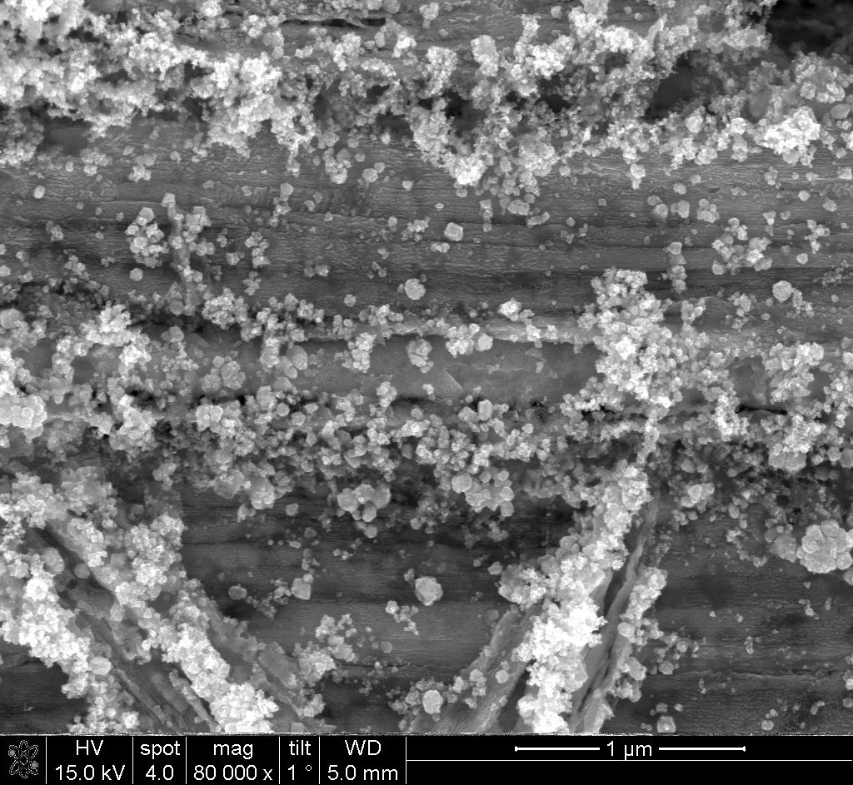
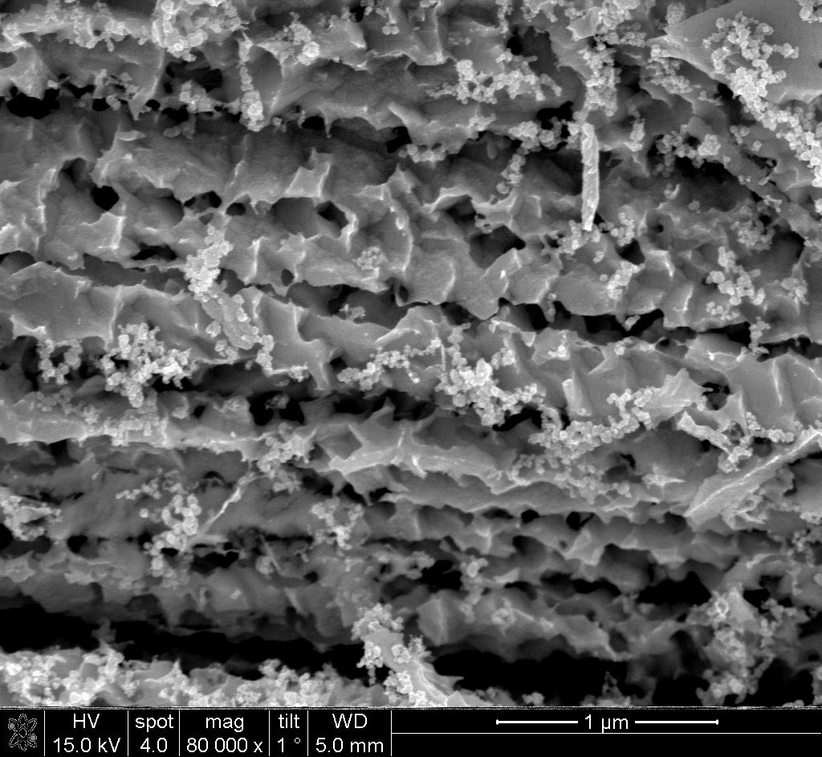
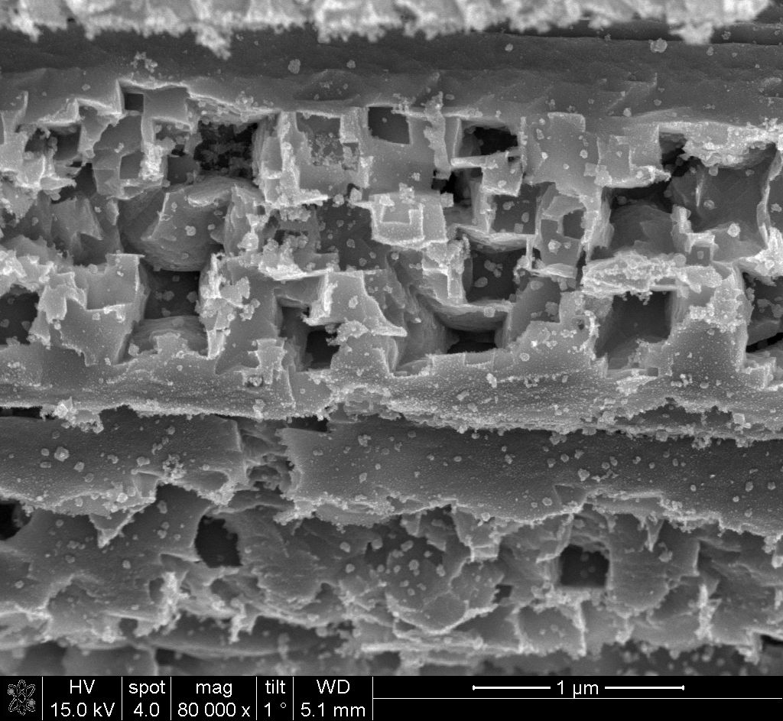
Pt wire after 10 minutes of cathodic treatment at -6 ± 0.5 V in NaOH
0.5 M
1 M
5 M
10 M
20 M
Cathodic corrosion of Platinum (?!)

Slide 9

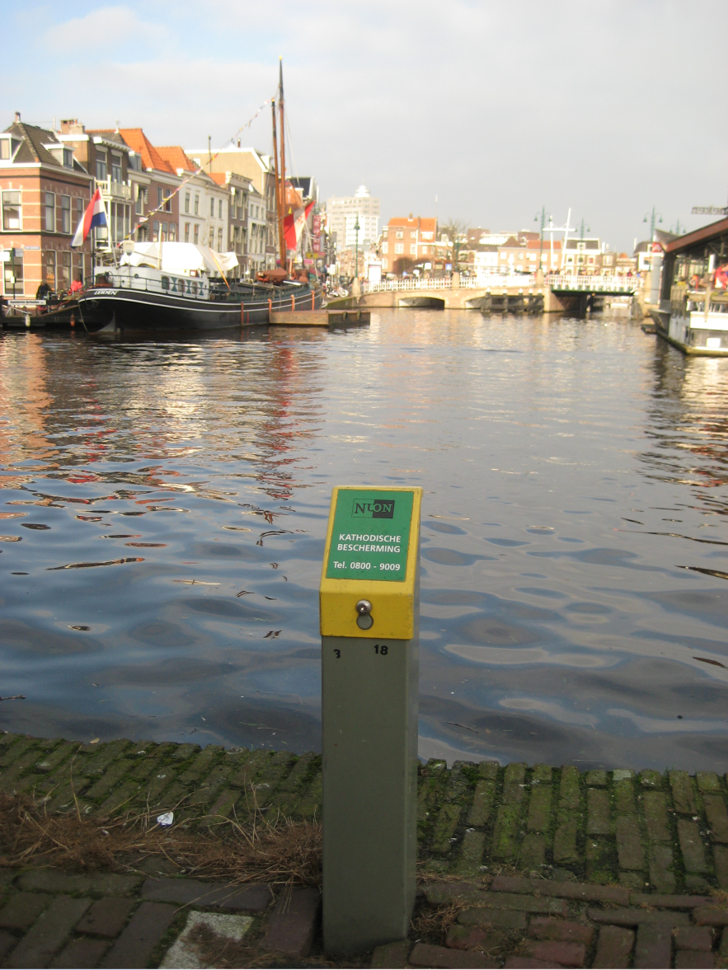
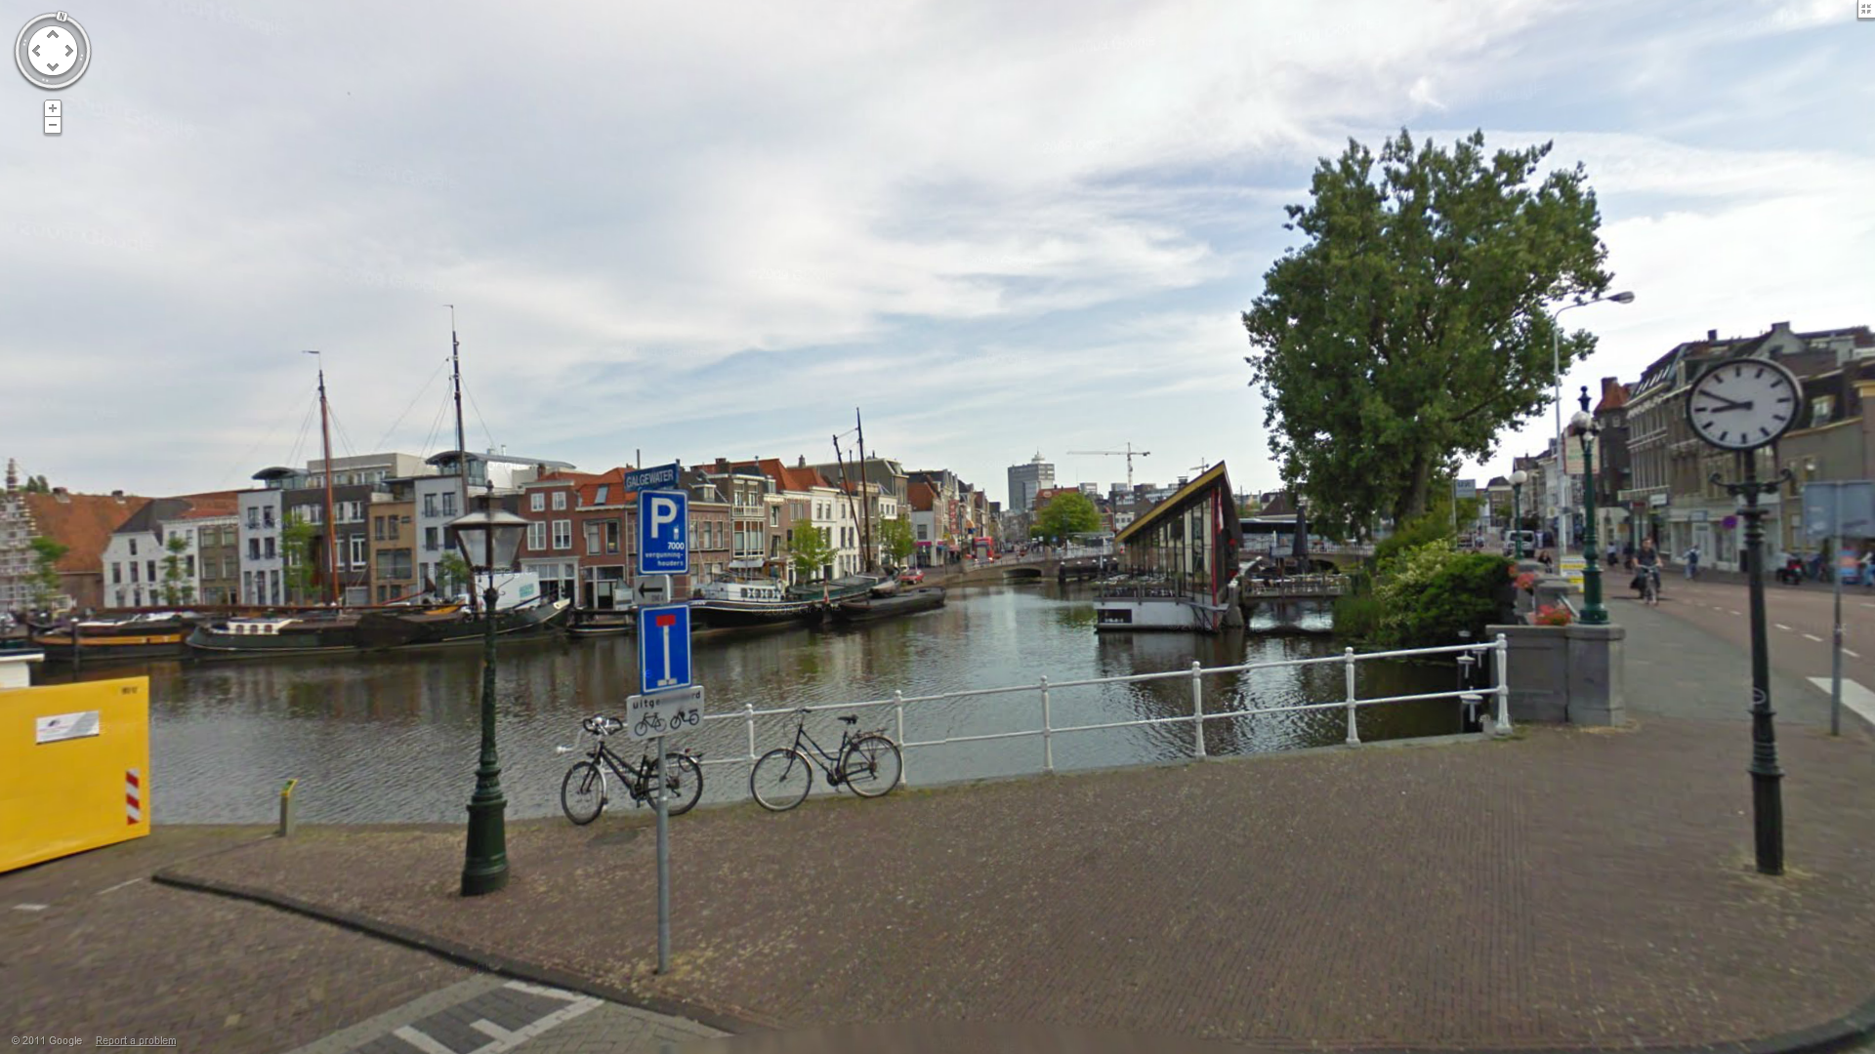
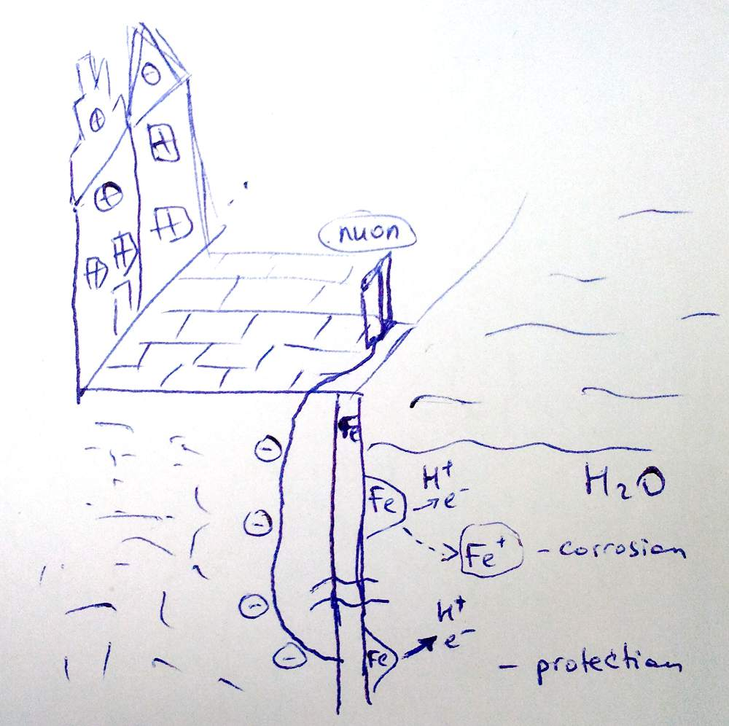
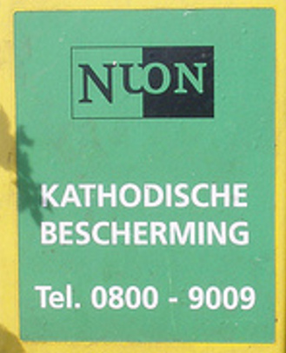
Cathodic corrosion of platinum
Nanoparticles (or so it seems)
Ingredients: Pt, C, Na, H, O, (negative pole!)
So what’s going on?
This is NOT what we observe!!!
Cathodic protection vs. cathodic corrosion

Slide 10
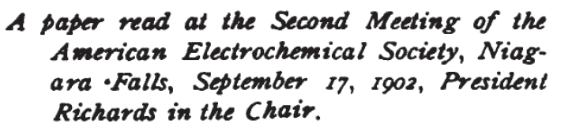

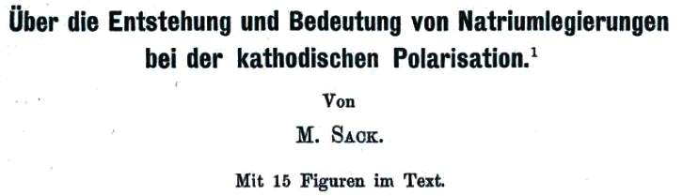
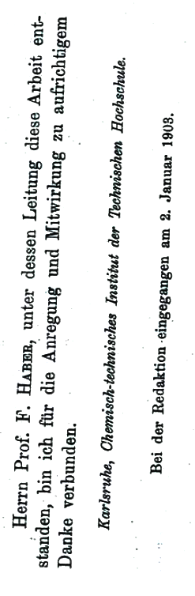
Surely someone must have seen this before?
Most popular explanations:
Alloying with reduced alkali metal and subsequent leaching by water
Hydrogen corrosion (formation of metal hydrides)
Physical disintegration
Historical note

Slide 11
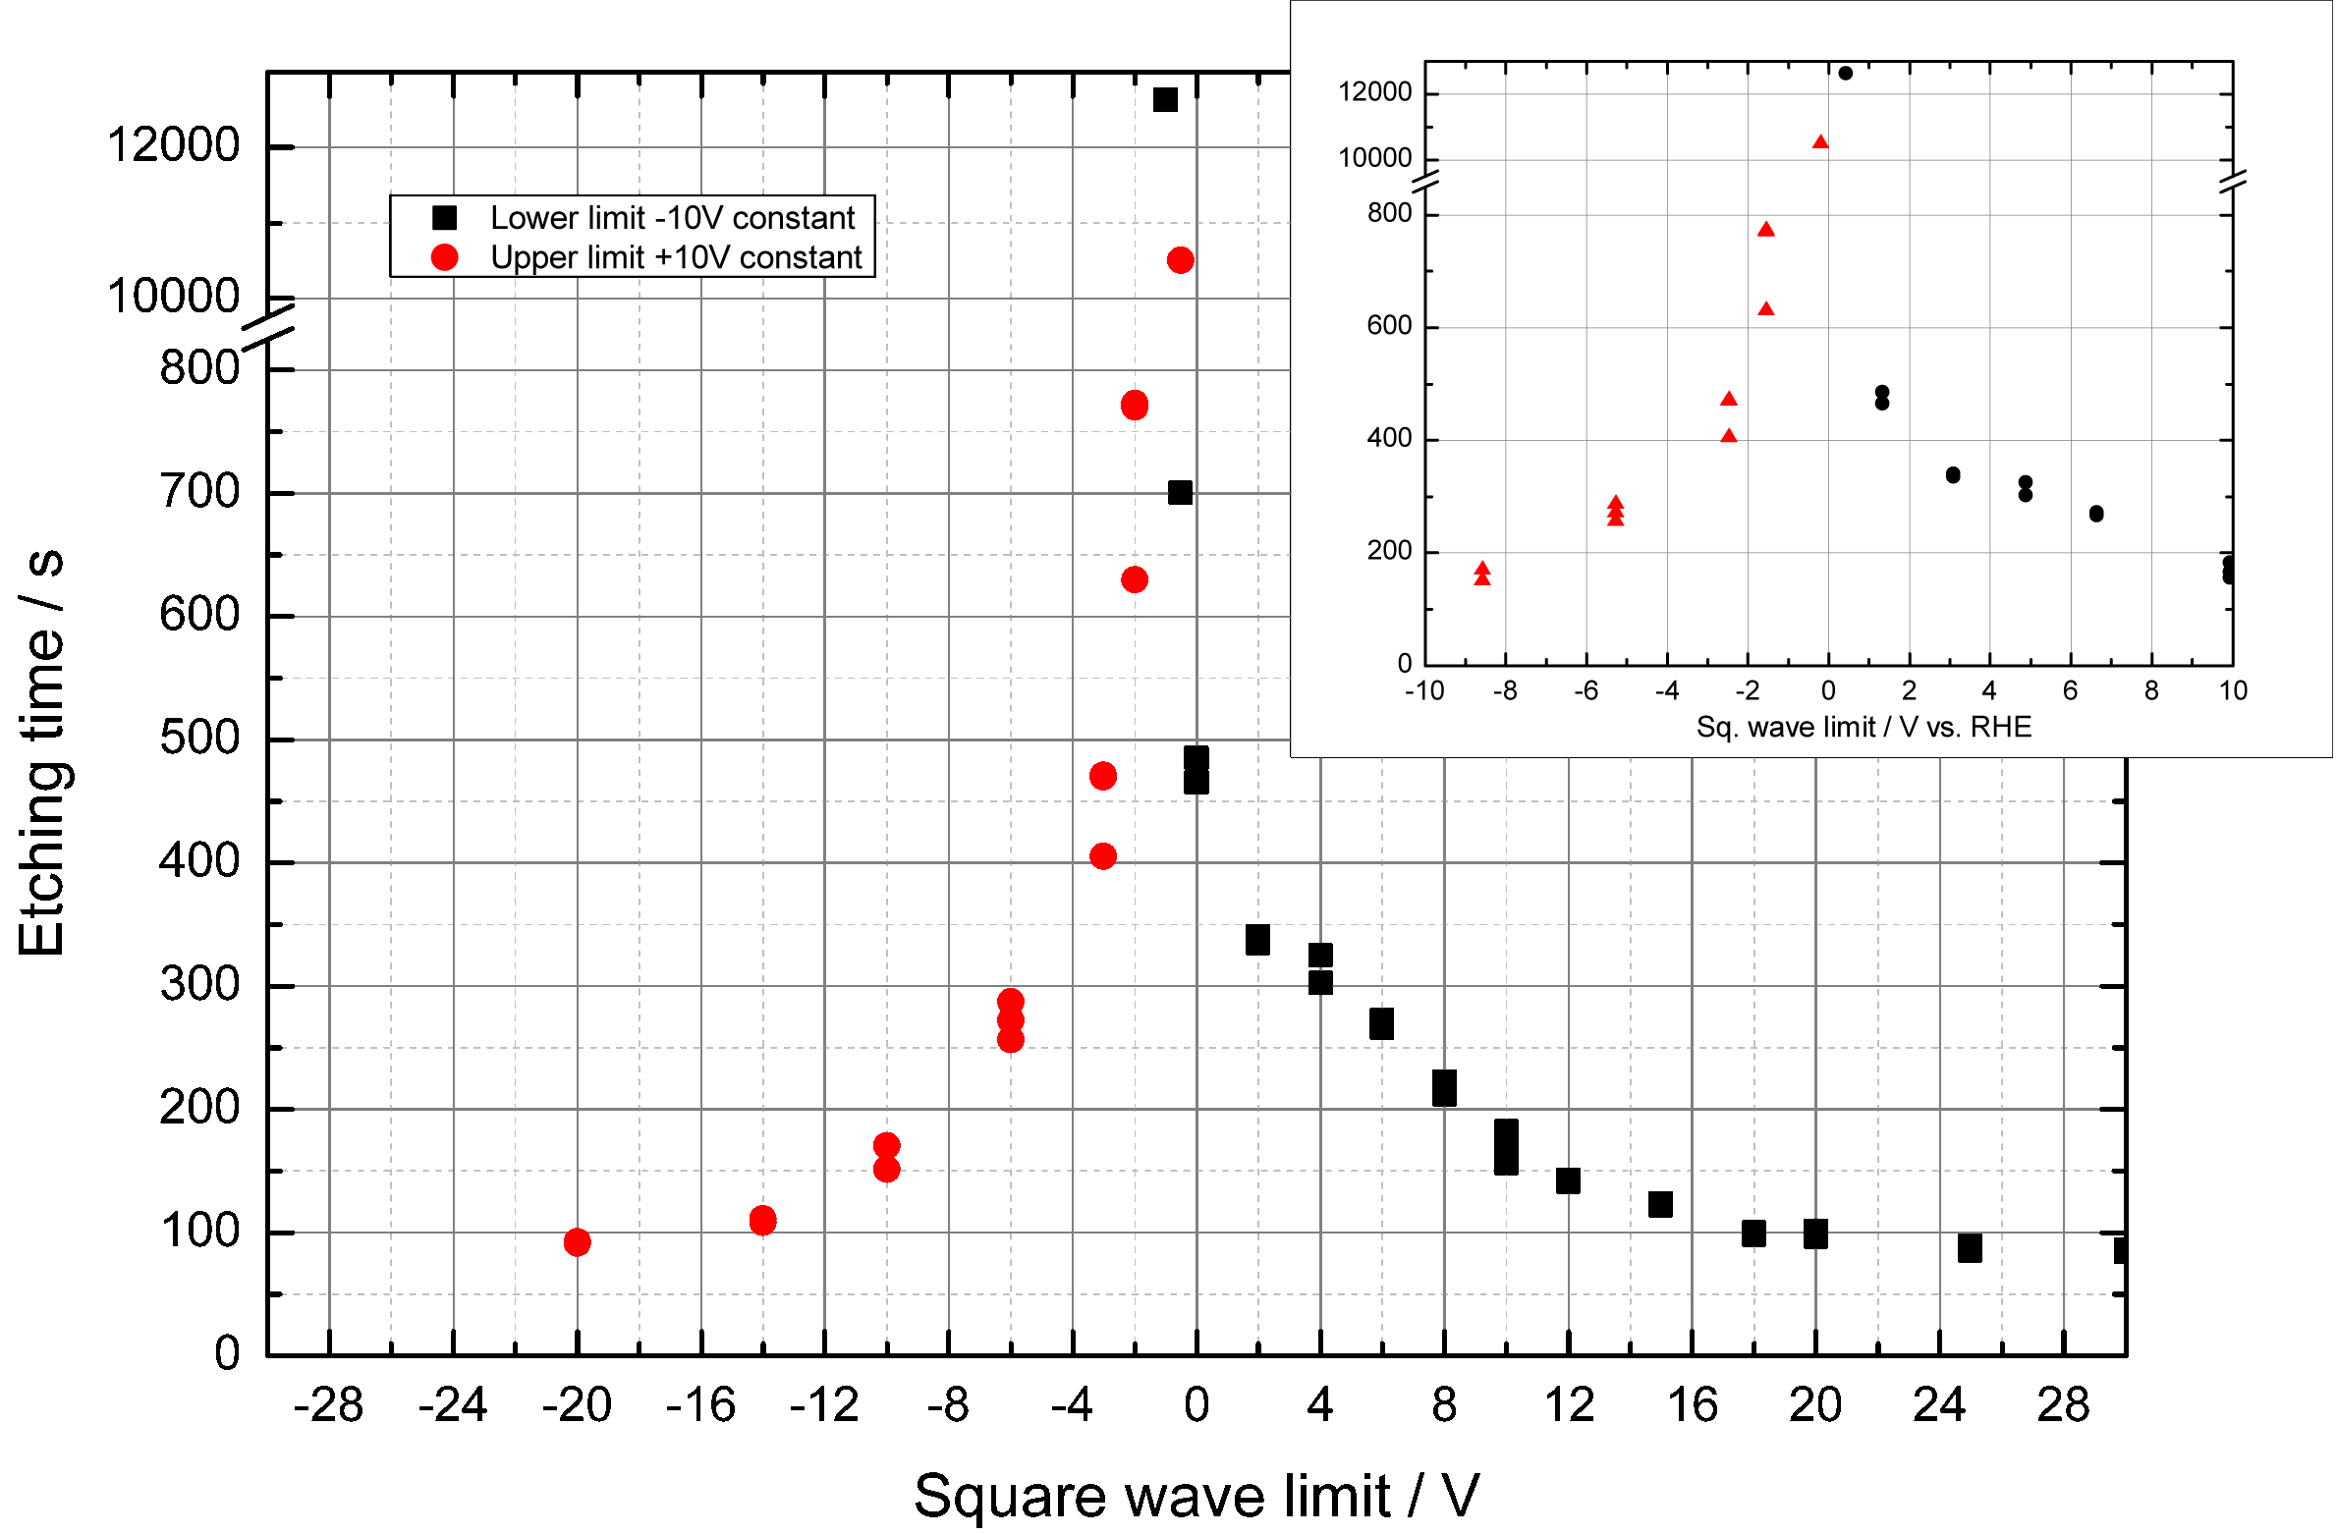
Alloying of a cathode metal with an alkali, and subsequent leaching of the alloy is inconsistent with the following observations:
At one given potential the alkali cation shows preference
both for reduction (alloying) and for oxidation (leaching)
Na⁺ + e⁻ ↔ Na(s) (-2.71 V)
At more cathodic potentials leaching should be suppressed completely.
Haber’s mechanism: alloying+leaching

Slide 12
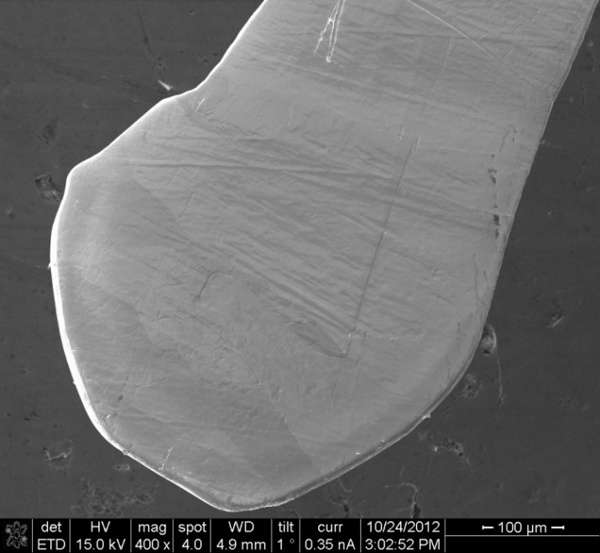
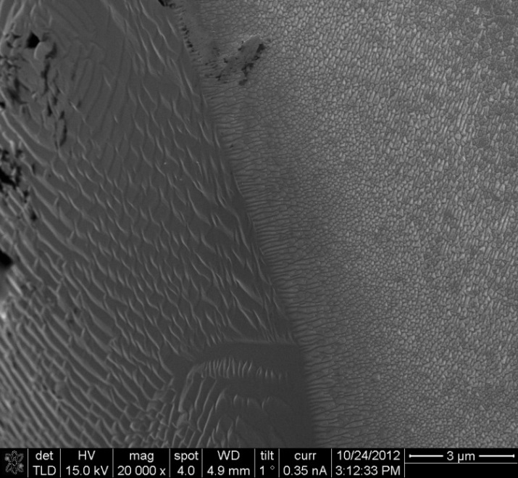

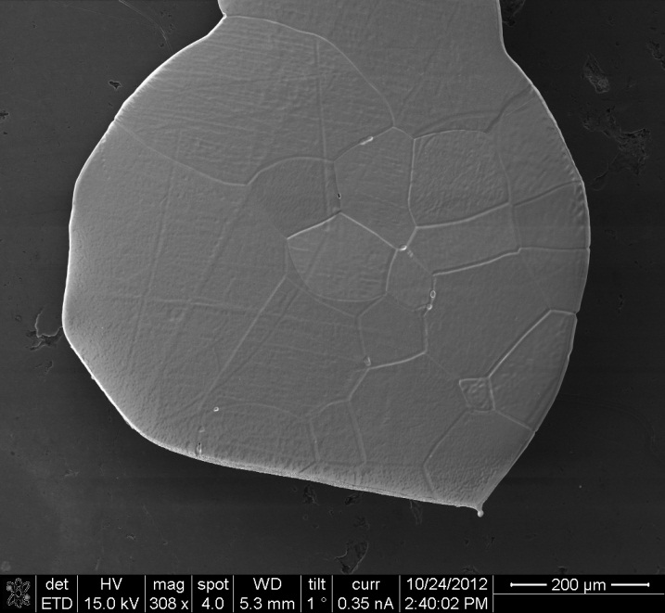
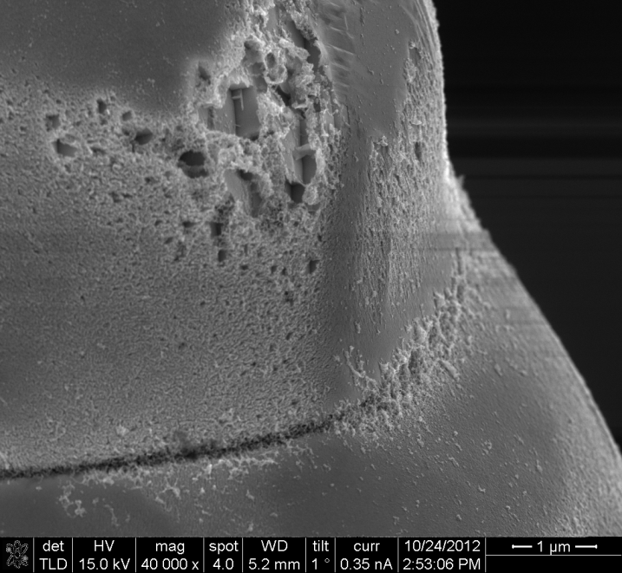
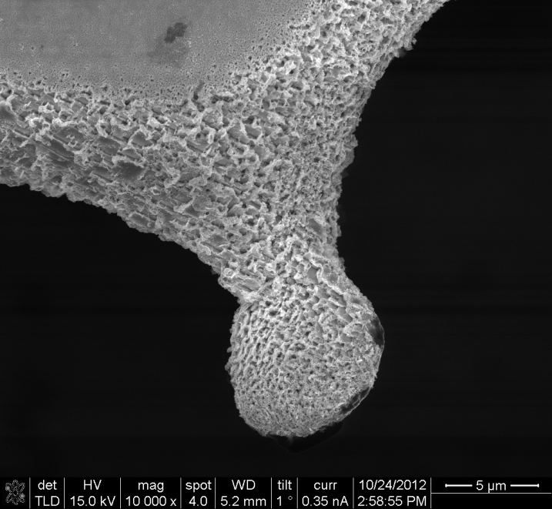
It can’t be alloying! But how do you prove it?
Idea: use a strong base which does not have an alkali
TMAH -10 to 0 Vac
TMAH -10Vdc

Slide 13
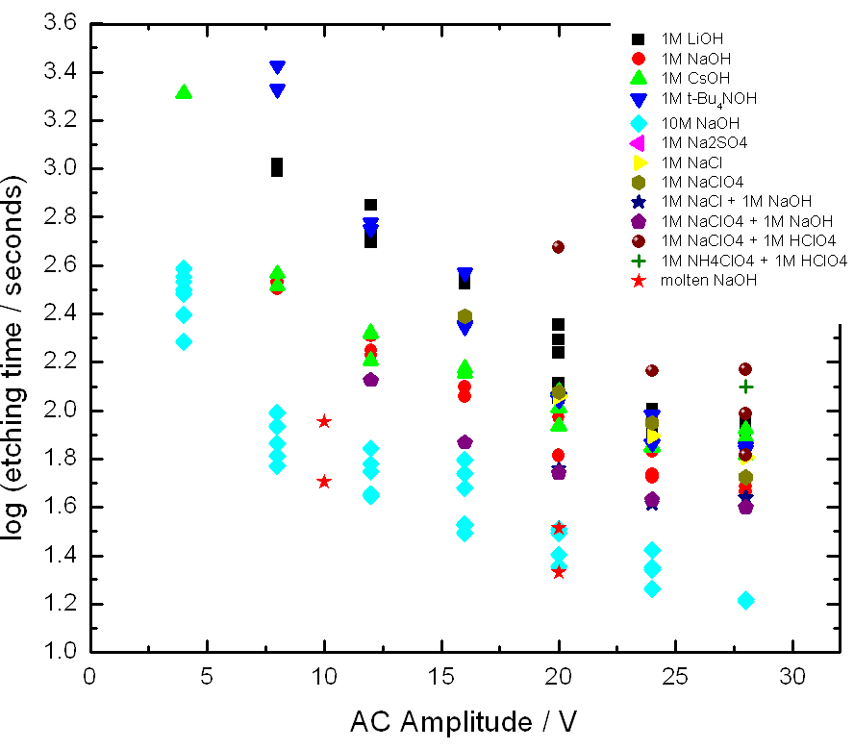
It can’t be alloying! But how do you prove it?
Idea: start with an acid, then add
an alkali salt of the same acid
Why this should work: conductivity,
heat conductivity, density and all
other physical properties
will remain the same (approx.).
Chemically, the only thing we add
is alkali cation.
Let’s see what that will do…
Most popular explanations:
Alloying with reduced alkali metal and subsequent leaching by water
Hydrogen corrosion (formation of metal hydrides)
Physical disintegration
The case of tetra-alkyl ammonium cations

Slide 14
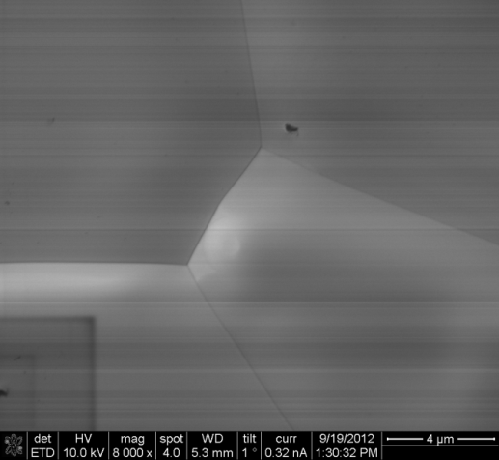
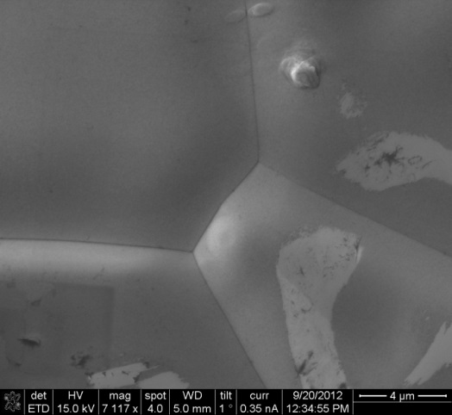
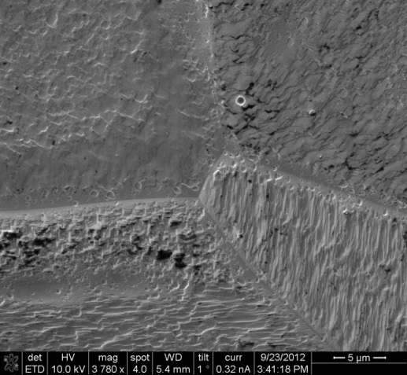
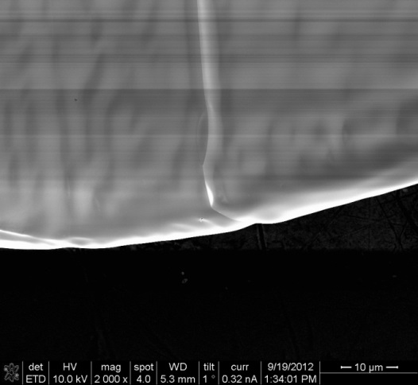
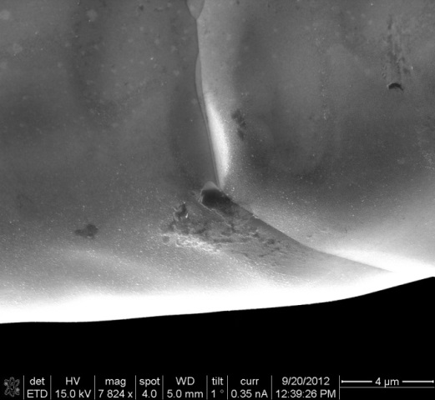
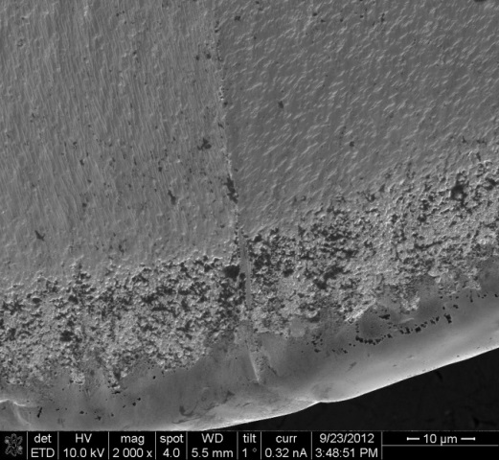
It can’t be alloying! But how do you prove it?
After annealing
-10 V in 2M H₂SO₄
-10 V in 1M H₂SO₄+ 1M Na₂SO₄
Most popular explanations:
Alloying with reduced alkali metal and subsequent leaching by water
Hydrogen corrosion (formation of metal hydrides)
Physical disintegration
Strong cation is key

Slide 15
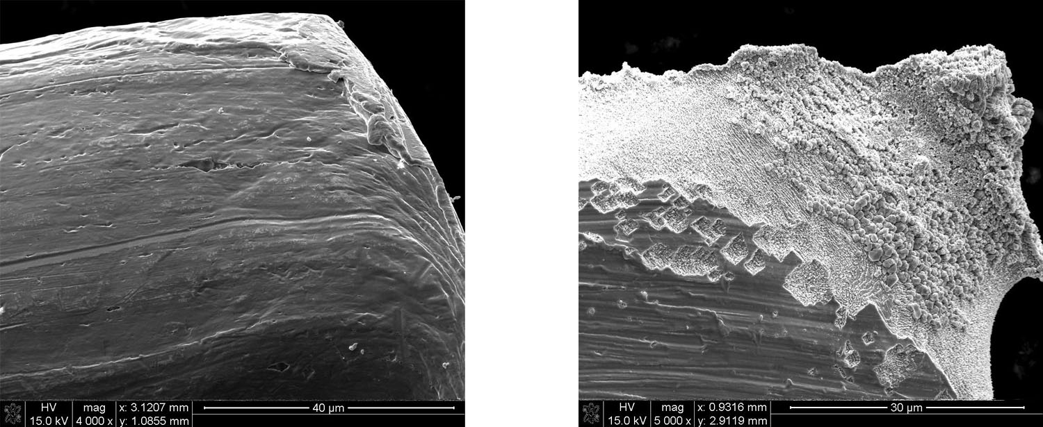
It’s not hydrogen, and also not physical disintegration
Au wire after 30 min at -10 V in 1M H₂SO₄ (left), and after 1M Na₂SO₄ was added (right).
Most popular explanations:
Alloying with reduced alkali metal and subsequent leaching by water
Hydrogen corrosion (formation of metal hydrides)
Physical disintegration
Strong cation is key

Slide 16
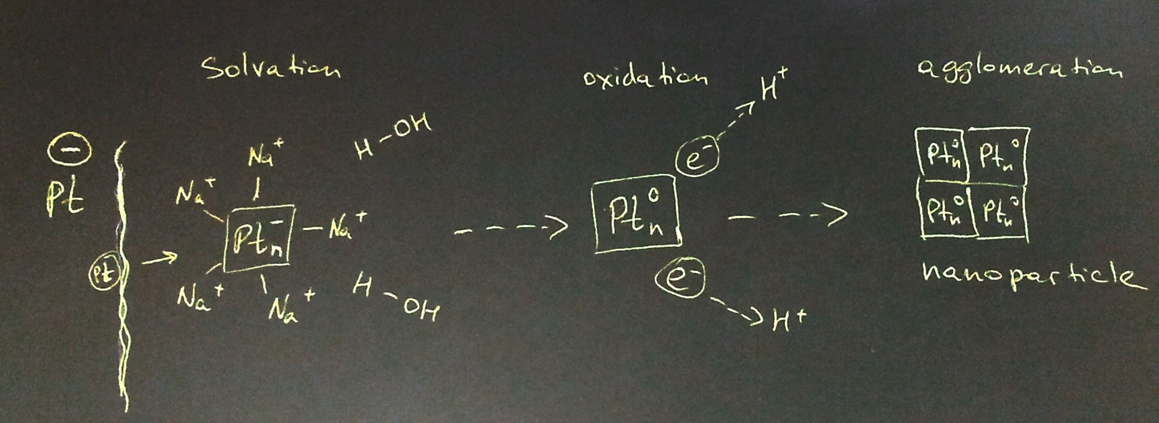
To summarize, in order to cathodically corrode a metal, we need:
a metal
a strong cation in aqueous solution
quite negative voltage
and thus the proposed mechanism of the reaction …
… the reaction must proceed via a negatively charged metal ion!
Yanson et al, Angewandte 50, 6346 (2011)

Slide 17
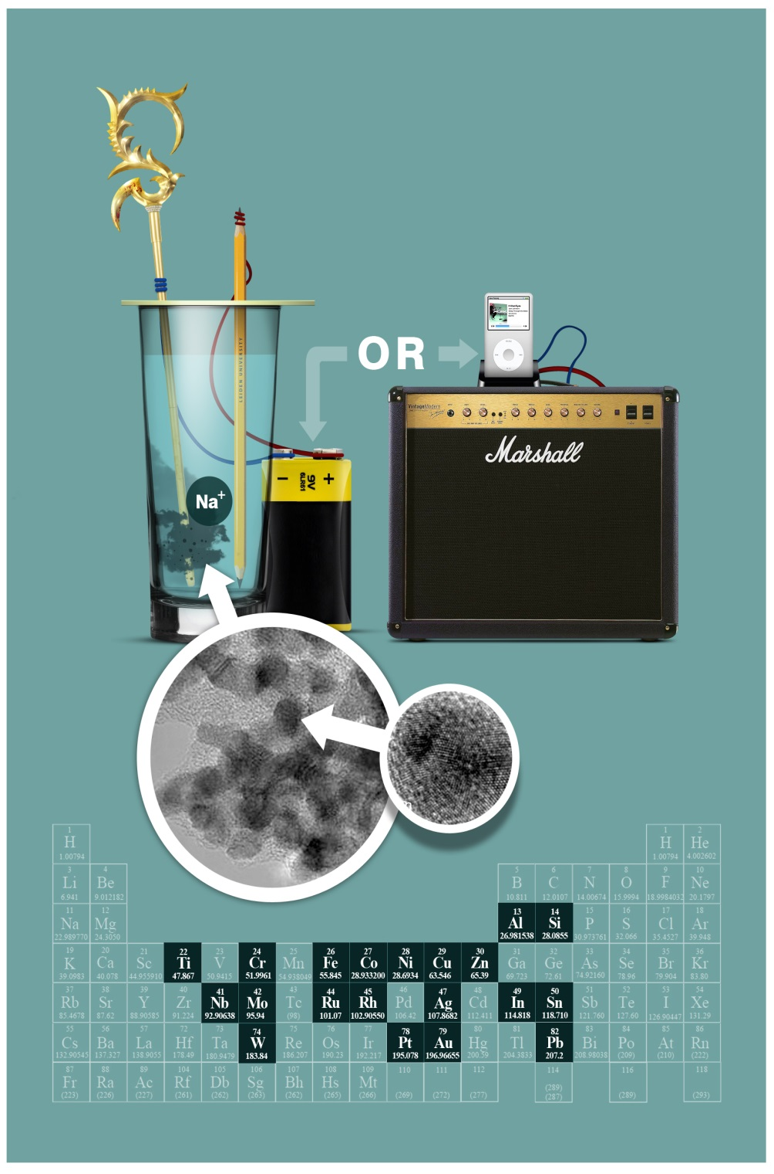
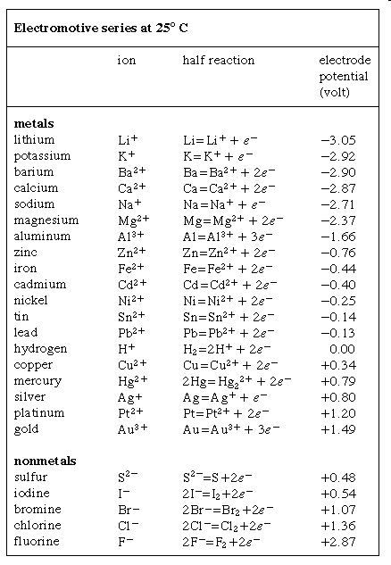

This is known:
This is waiting
to be
discovered!
etc etc etc

Slide 18


What is known of metal anions
In 1907 experiments in liquid ammonia by Kraus produced species of Na⁺ and Pb₂⁻
In the 1930’s Zintl deduced the existence of Na₄Pb₉,
or a “Zintl ion” Pb₉⁴⁻. Also detected anion Au⁻
By the end of 1940’s anions of Hg⁻, Au⁻ and Li⁻
were identified in gas phase by mass-spec
In the 1950’s the first solid ionic compounds of the
type Cs+Au- were synthesized in vacuum
In 1980’s unambiguous evidence appeared for the existence
of monatomic metal anions in solution and the solid state
In 2003 a Cs₂Pt solid containing Pt²⁻ anion was obtained
Ge₉⁴⁻
Cs₄Ge₉
History of metal anions

Slide 19
Low-temperature STM of Au atoms on NaCl
J. Repp, G. Meyer, F.E. Olsson, and M. Persson, Science 305, 493 (2004)
… they exist, but are hard to find and handle (intolerant to air, water, anything reducible)
An example of a gold anion from physics

Slide 20
In 1907 experiments in liquid ammonia produced species of Na⁺ and Pb₂⁻
In the 1930’s Zintl deduced the existence of Na₄Pb₉,
or a “Zintl ion” Pb₉⁴⁻. Also detected anion Au⁻
By the end of 1940’s anions of Hg⁻, Au⁻ and Li⁻
were identified in gas phase by mass-spec
In the 1950’s the first solid ionic compounds of the
type Cs+Au- were synthesized in vacuum
In 1980’s unambiguous evidence appeared for the existence
of monatomic metal anions in solution and the solid state
In 2003 a Cs₂Pt solid containing Pt²⁻ anion was obtained
Ge₉⁴⁻
Cs₄Ge₉
Onset potential for Pt is less negative than -2V !

Slide 21





How does the corrosion product look like?
Characterization of cathodic nanoparticles

Slide 22



Characterization of cathodic nanoparticles
TEM
XRD
Size distribution
200
180
160
140
EDX
120
100
80
60
40
20
0
0-2
2-4
4-6
6-8
8-10
10-12
12-14
14-16
16-18
18-20
20-22
22-24
More
nm
Physical characterization

Slide 23

Catalytic activity of cathodic platinum nanoparticles
Black – commercial (TKK) 5 nm
Red – cathodic platinum 8-10 nm
Hydrogen adsorption
CO monolayer oxidation
Methanol oxidation
Fuel cell performance of CathNP

Slide 24

Single crystal Pd data for reference (10mV/sec)
Pd cathodic nanoparticles
(111)
(100)
(110)
M. Hara et al. / Electrochimica Acta 52 (2007) 5733–5748
Blank voltammetry of Pd CathNP

Slide 25
Single crystal Rh data for reference (1mV/sec)
Rh cathodic nanoparticles
(111)
(100) or (110)
(100)
(110)
Q. Xu et al. / Electrochimica Acta 54 (2009) 5509
Blank voltammetry of Rh CathNP

Slide 26

Powder X-ray diffraction:
2-1-2 peak sequence is typical of fcc metal crystals
Positions of the peaks coincide with those expected for the crystal structure of a corresponding metal
Widths of the peaks give indication for the average crystallite size to be 25, 58, 12, 57 and 6 nm, respectively (Scherrer formula).

Slide 27


Any electrolyte, any metal
We have confirmed the ac formation of suspended nanoparticles for Pt, Au, Cu, Ag, Ni, Rh, Re, Al, Ti, Si, Nb and Ru - in fact every metal we have tried (except Pd)
Any electrolyte works, any pH, as long as it has a strong cation
Pt
Au
Rh
Ag
Re

Slide 28

… what if the starting wire is an alloy?
EDX analysis
of nanoparticles
Rodriguez, Yanson, JACS 133, 17626 (2011)
… then we get alloyed nanoparticles!

Slide 29
Electrochemistry of PtRh NPs
CO stripping
Rh
Pt20Rh80
Methanol
oxidation
Pt70Rh30
0.5M H₂SO₄ + 0.5M
CH₃OH, 20 mV/sc
Pt90Rh10
Pt
Nitrate
reduction
Blank CV
Pt (-----)
Pt90Rh10 (-----)
Pt70Rh30 (-----)
Pt20Rh80 (-----)
Rh (-----)
0.5M H₂SO₄ +
0.1M NaNO₃, 20 mV/s
Rodriguez, Yanson, JACS 133, 17626 (2011)

Slide 30

Electro-oxidation on cathodic Pt₉₅Ru₅ nanoparticles
Methanol oxidation
CO stripping
Rodriguez, Yanson, JACS 133, 17626 (2011)
0.5M H₂SO₄ + 0.5M CH₃OH, 20 mV/sc

Slide 31


Size-controlled synthesis of cathodic nanoparticles
We can simply control the size of the cathodic NPs,
without sacrificing size distribution
Antonov, Yanson , Electrochim. Acta 110, 796 (2013)

Slide 32



Preferentially-oriented Pt(100) nanoparticles
% (100) sites
59% -----
55% -----
35% -----
31% -----
0.5 M H₂SO₄, 50 mV/s
DME oxidation
NH₃
oxidation
0.2M NaOH + 0.1M NH3
10 mV/s

Slide 33
Nitrite reduction to N₂ on cathodic Pt(100) nanoparticles
Duca, Yanson , Topics in Catalysis 57, 255 (2014)
0.1M NaOH +2mM NaNO₂, 1 mV/s

Slide 34


Prof. M. T. M. Koper
Dr. Matteo Duca
Dr. Yuriy Yanson
Rik Mom
Rico Wanders
Pavel Antonov
Prof. Oosterkamp (SEM)
Prof. Reedijk (XRD)
Leiden University
Dr. Paramaconi Rodriguez,
Paul Scherrer Institute &
University of Birmingham
Dr. Nuria Garcia,
University of Southampton
Prof. N. Markovic
Argonne National Lab
Prof. P. Unwin
Dr. S. Lai
University of Warwick
Dr. Frans Tichelaar (TEM, EDX)
Dr. Patricia Kooyman (TEM)
TU Delft

Slide 35

Facile preparation of Pt hydrosols by dispersing bulk Pt with potential perturbations
Wei Huang, Shu Chen, Jufang Zheng, Zelin Li, Electrochemistry Communications 11 (2009) 469
Reference discovered accidentally during an irrelevant literature search on 31-05-2011
… unaware, we wrote an article (published online 27-05-2011) and applied for a patent

Slide 36
Stability of cathodic Pt(100) nanoparticles

